Slide 1

Stochastic modeling of flow and transport in highly heterogeneous porous formations
Gedeon Dagan
Tel Aviv University, Israel
Aldo Fiori
Università di Roma Tre, Italy
Special Semester on
Multiscale Simulation & Analysis in Energy and the Environment
Linz, October 3-December 16, 2011
Numerical Analysis of Multiscale Problems & Stochastic Modelling

Slide 2
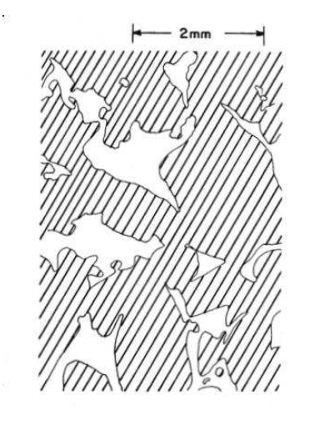
The local equations of flow and transport: General definitions
We consider water flow and solute transport through porous media.
A porous medium is an interconnected network of voids (pores) in a solid material
The characteristic length scale d is the pore size: from μm to mm.
The interest is generally in porous bodies of scale L>>d.

Slide 3
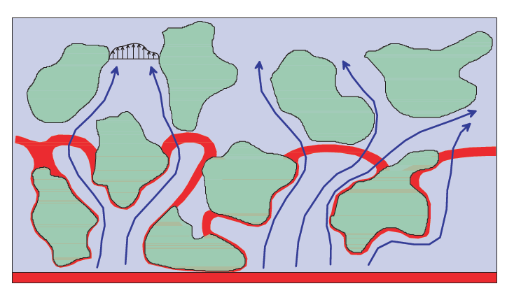
Scales
Flow and transport at the pore scale (microscopic scale) are complex due to the geometry (even for artificial media, e.g. mixture of small spheres of equal diameter)
The problem is simplified by defining macroscopic variables: averaging over volumes of scale ℓ, justified by the hierarchy d<<ℓ<<L.

Slide 4
Basic properties
The simplest property is the porosity n=(Volume voids)/(Total volume), n<1
In a similar manner macroscopic variables:
  q - specific discharge (fluid discharge/area of medium)
  V=q/n - pore velocity
  p - pore pressure
  H=(p/(ρg))+z - head (ρ is density, z is elevation)
  C - solute concentration (mass of solute/volume of fluid)

Slide 5
Macroscopic scale
Macroscopic variables constitute continuous space fields: the porous medium is replaced by a continuum.
Value of variable at a point x: average over a volume (area) of scale ℓ whose centroid is at x.
Homogeneous medium: no change with x.
Nonhomogeneous medium: slowly varying (scale >>ℓ).

Slide 6
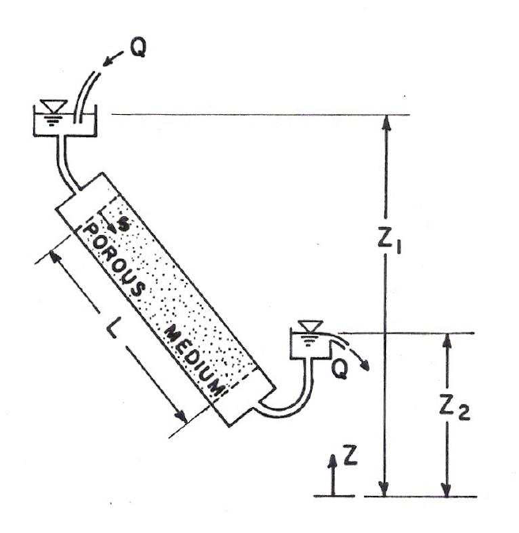
Flow
Experimental determination of flow and transport equations: a laboratory column or a sample (core) of scale L>ℓ.

Slide 7


Flow equations
Darcy's law:
K : hydraulic conductivity (permeability). In nature: 10⁻¹≲K(cm/sec)≲10⁻⁶
Generalization for 3D flow in space
For incompressible matrix and fluid, conservation of mass

Slide 8


Flow equations (cont.)
Elimination of q leads to
For homogeneous media
General problem of steady flow: given a space domain Ω, given K(x), given boundary conditions H or q_{normal} on boundary ∂Ω, determine H(x) satisfying flow equation for x∈Ω. Subsequently: q(x)=-K∇H, V(x)=q/n.

Slide 9
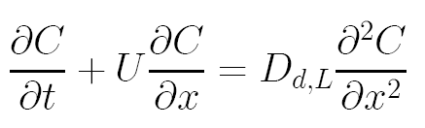
Solute transport
At t=0 a conservative solute (tracer) at constant concentration C₀ is inserted at the column entrance x=0; water flows at constant velocity U=q/n.
The BTC (breakthrough curve) at the outlet C(L,t) has an inverse Gaussian shape. C(x,t) obeys the ADE (advective dispersion equation) of solute mass conservation

Slide 10



Solute transport
The solute flux is made up from the advective component UC and the dispersive one
: local pore scale dispersion longitudinal coefficient. For Pe>>1 (Pe=Ud/D₀, with D₀ molecular diffusion coefficient O(10⁻⁴ cm²/sec)
D_{d,0}<D₀: effective coefficient of molecular diffusion; α_{d,L}:pore scale longitudinal dispersivity O(d).
For Pe>10: α_{d,L}U>>D_{d,0}→ mixing due to microscopic velocity variations overrides molecular diffusion.

Slide 11
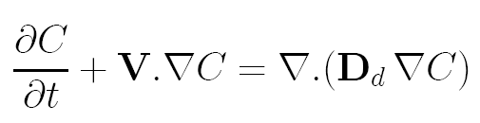
Solute transport
Generalization for transport in space
D_{d} is the pore scale dispersion tensor. Its principal axes are in the direction of V (longitudinal D_{d,L}=D_{d,0}+α_{d,L}U) and normal to V (transversal D_{d,T}=D_{d,0}+α_{d,T}U) →D_{d}(D_{d,L},D_{d,T},D_{d,T}).
Generally α_{d,T}<<α_{d,L} (~1/40). If solute is reactive (decay, sorption) a source term has to be added.

Slide 12
General problem of transport
Given a space domain Ω, given the velocity field V(x) solution of the flow problem, given α_{d,L} and α_{d,T}, given initial and boundary conditions for C (e.g. instantaneous or continuous injection in a subdomain of Ω), determine C(x,t) satisfying the transport equation.
Simple case: instantaneous injection of a fluid body of constant concentration C₀ at t=0 in a spherical domain, for constant U. The centroid of the solute body moves with U, and surfaces of constant C are elongated ellipsoids.

Slide 13
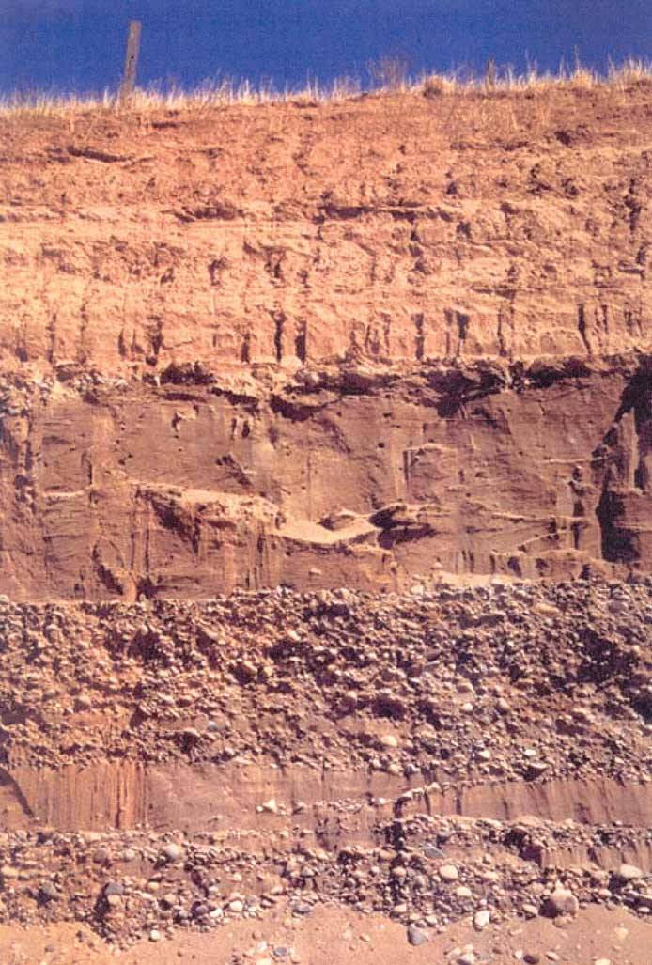
Heterogeneity of natural formations
Natural formations (aquifers, petroleum reservoirs) are characterized by scales L =O(10¹-10³meters). Their properties vary in space over scales I much larger than the laboratory scale ℓ.
The hierarchy L>>I>>ℓ>>d is assumed to prevail.

Slide 14
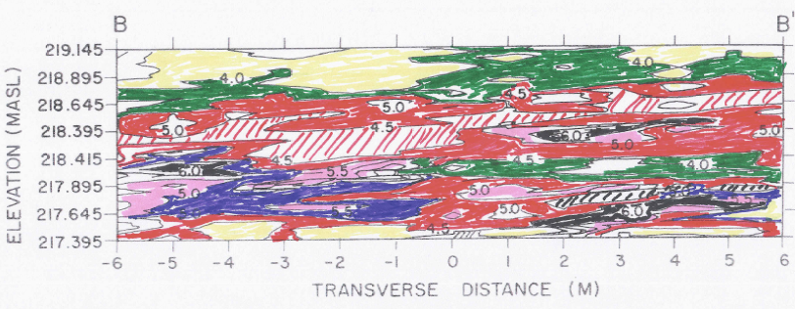
Heterogeneity: Hydraulic conductivity
The property of highest spatial variability is K, which may vary by orders of magnitude in the same formation. It is irregular (seemingly erratic) and generally subjected to uncertainty due to scarcity of data.
Conductivity distribution in a cross section of the Borden Site aquifer in Canada (lines of constant –lnK, cm/sec)

Slide 15
Heterogeneity as a random property
K(x), or equivalently Y=lnK, is modeled in statistical terms as RSF (random space function).
The actual formation is regarded as a realization of an ensemble of replicates of same statistical properties.
The ensemble is a convenient mathematical construction to tackle variability and uncertainty. Replicates can be generated numerically by Monte Carlo simulations.

Slide 16
Statistical characterization of hydraulic conductivity
The statistical structure of the RSF Y(x) can be quantified by the joint PDF (probability density function) of its values at an arbitrary set of points Y_{i}=Y(x_{i}): f(Y₁,Y₂,…,Y_{N}). In turn by various moments
In many formations the univariate f(Y) was found to fit a normal distribution
where Y’=Y-<Y>, <Y(x)> ensemble mean, σ_{Y}² is the variance.

Slide 17


Statistical characterization (cont.)
The bivariate f(Y₁,Y₂) is characterized at second order by the means, the variances and the two-point covariance C_{Y}(x₁,x₂)=〈Y′(x₁)Y′(x₂)〉.
If Y is bivariate normal, it is completely defined by these moments.
Stationary RSF:
  〈Y(x)〉=const, σ_{Y}²=const
  C_{Y}(x₁,x₂)=σ_{Y}²ρ_{Y}(r) (r=x₁-x₂). Isotropic: ρ_{Y}(r), r=|r|
  Integral scale: Anisotropic:

Slide 18


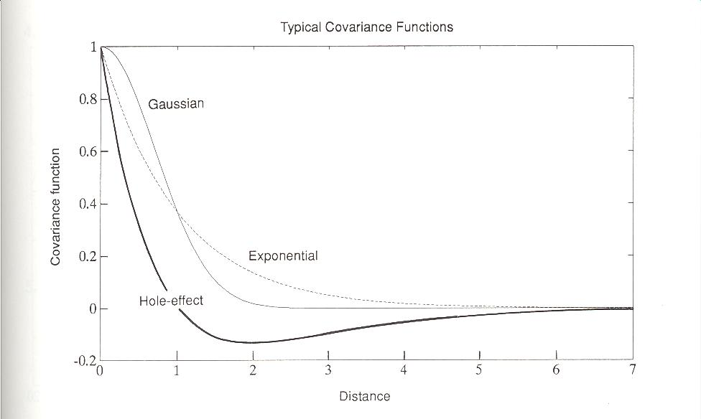

Statistical characterization (cont.)
Common examples of isotropic
Anisotropic:
For axisymmetric anisotropy I_{x}=I_{y} and f=I_{z}/I_{x}=I_{vertical}/I_{horizontal} is the anisotropy ratio, generally f<1.
At second order and for an adopted PDF, the statistical structure is characterized by the parameters:

Slide 19
Ergodic hypothesis
If the length scale L of Ω, L >>I, ensemble averaging can be exchanged with space averaging, e.g.
Since only one realization of formation is available, the hypothesis is generally adopted and identification of statistical structure is carried out by using spatial data of the given formation.
Due to scarcity of data and ergodic limitations practically only the hystogram i.e. f(Y)→〈Y〉,σ_{Y}² and the covariance can be identified. If it is assumed that Y(x_{i}) is multi-Gaussian, this information is complete.

Slide 20
Stochastic modeling of flow and transport in natural formations
Since the flow equation ∇²H+∇H.∇Y=0 contains the RSF Y, it is a stochastic equation.
The variables H(x,t),q(x,t),V(x,t),C(x,t) are RSF and are defined by the joint PDF of their values at different x and t
The general problem of stochastic modeling: given a space domain Ω, given the RSF Y(x) i.e. K(x), given n, α_{d,L}, α_{d,T} (generally assumed constant), given initial and boundary conditions for H and for C, determine the RSF H,V by solving first the flow equation and subsequently the RSF C(x,t) satisfying the transport equation.

Slide 21
Solutions: numerical Monte Carlo
The conceptually simple and most general approach is by Monte Carlo simulations: realizations of Y are generated, the deterministic equations for each realizations are solved M times, and the complete statistics is determined at N points.
It is computationally extremely demanding and does not lead to insight. At present and for highly heterogeneous formations, they are numerical experiments at most.

Slide 22

Solutions: approximate analytical
We proceed with approximate solutions for the following simplified conditions:
  stationary
  unbounded domain Ω (i.e. x is far from the boundary)
  steady flow, uniform in the mean 〈V〉=U=const (caused by a uniform mean head gradient ∇〈H〉=-J applied on the boundary approximately valid for natural gradient flow)

Slide 23
Solutions: approximate analytical (cont)
After solving for V, transport equation is solved by assuming:
  a conservative solute at low concentration
  the solute initial condition is of instantaneous injection of a plume at constant C₀ in a volume V₀ or an injection plane normal to the mean flow on an area A₀
  the length scale of V₀ or A₀ are much larger than the integral scale of Y in the transverse direction
  This idealized scenario may be applied after adaptation to actual formations for natural gradient flows, which are slowly varying in space. In contrast, highly nonuniform flows caused by pumping or injecting wells are more complex.

Slide 24
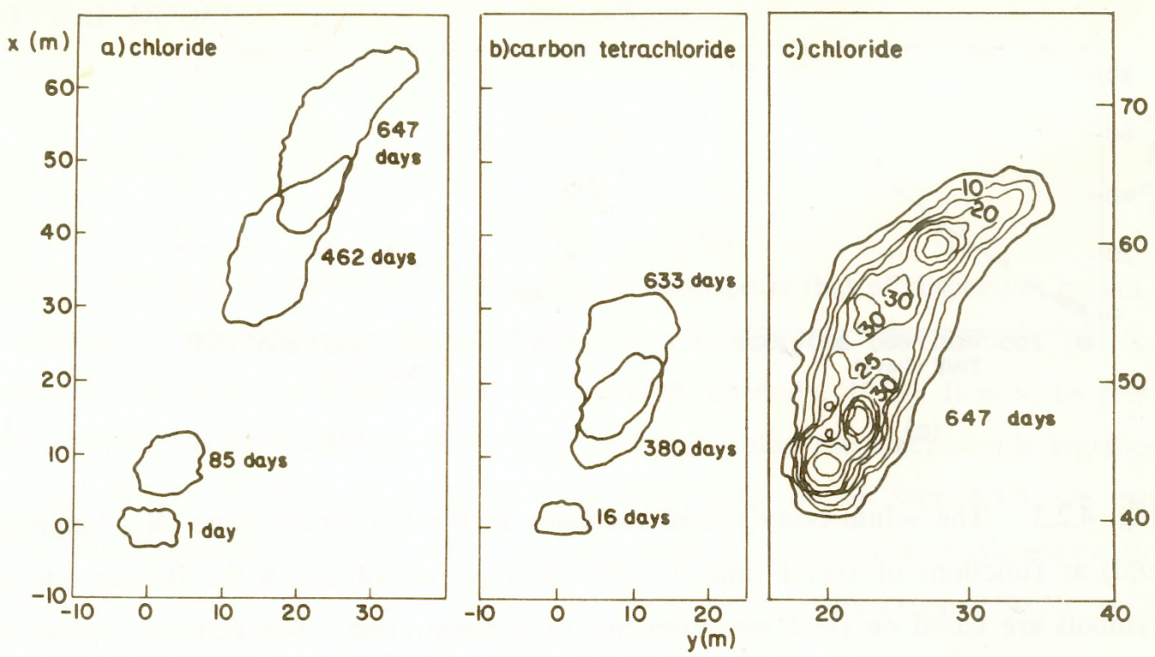
Impact of heterogeneity on transport: a few examples
Heterogeneity of K(x) has a major effect on transport, which is enhanced by orders of magnitude as compared to local pore scale dispersion.
Isoconcentration lines for the Borden experiment

Slide 25
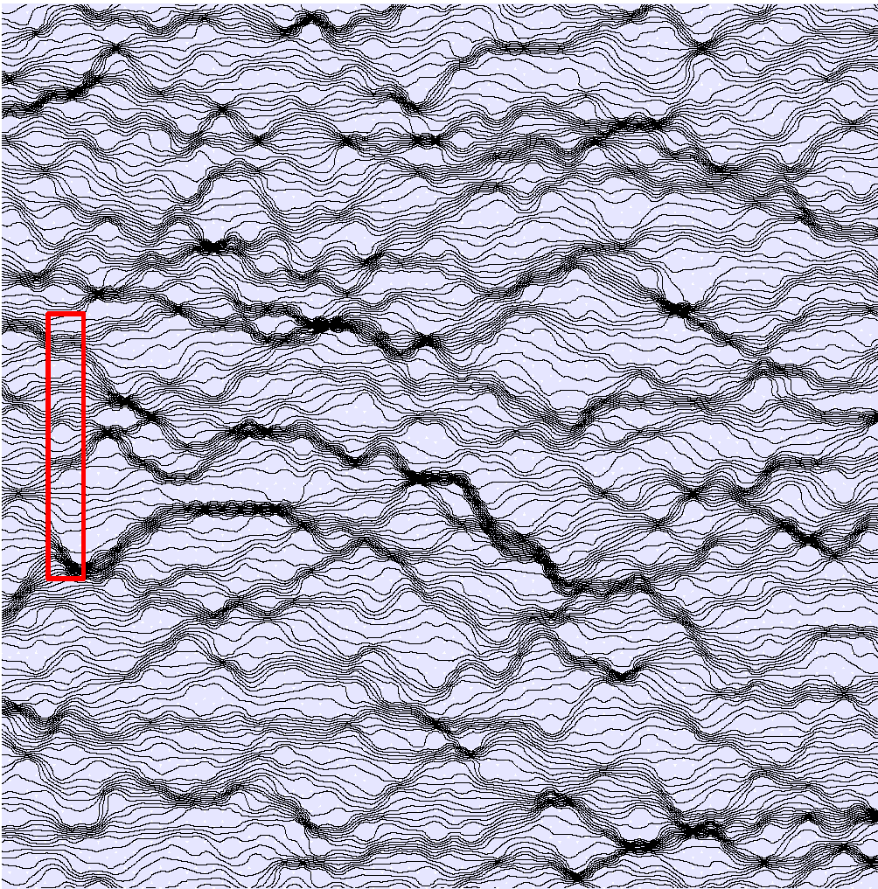
Numerical Laboratory (2D example)
tU/I_{h}=0

Slide 26
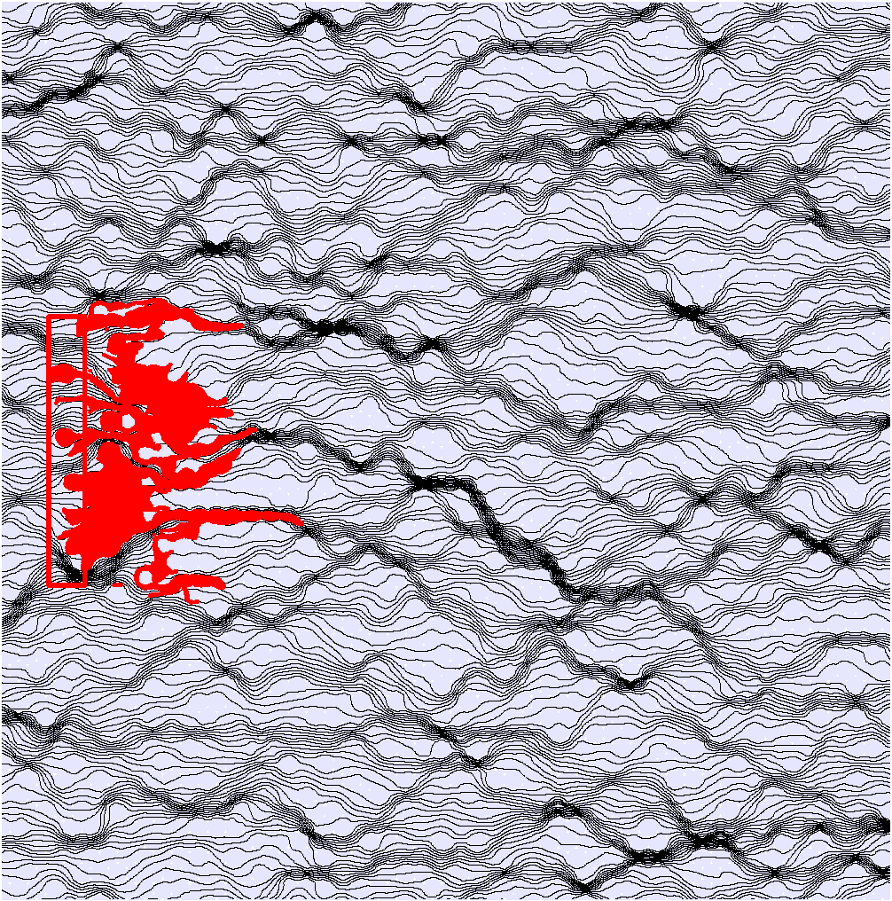
tU/I_{h}=7.5

Slide 27
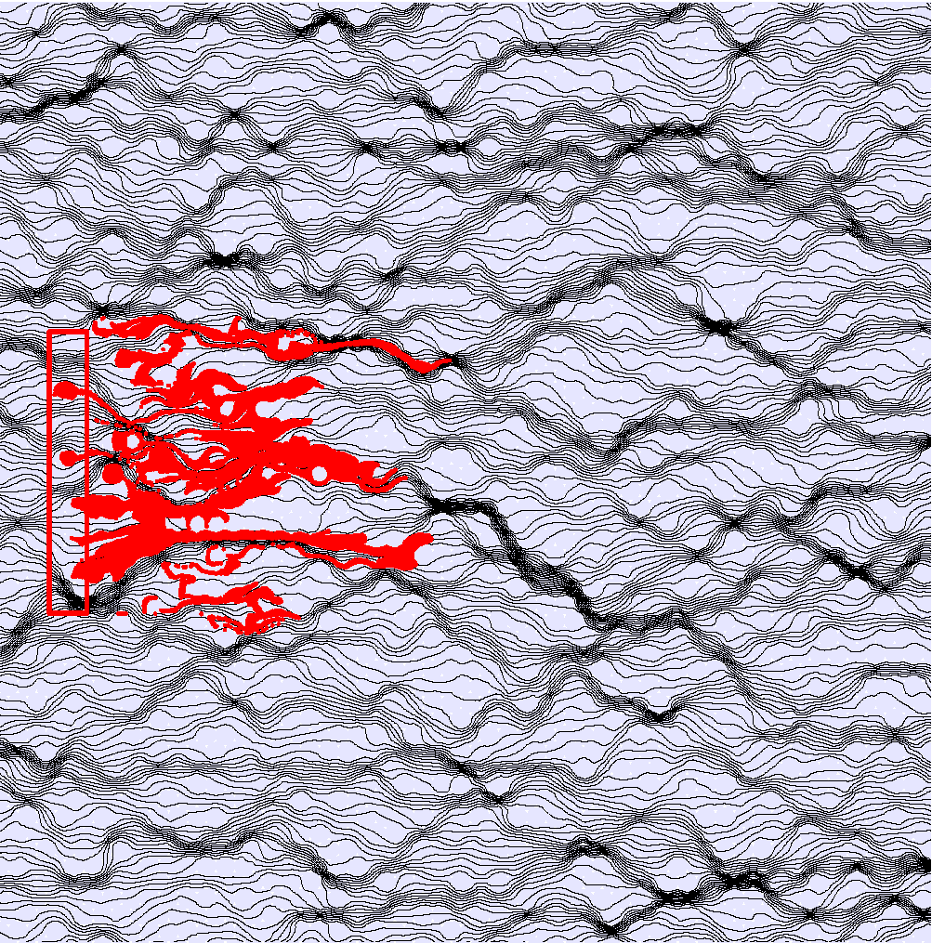
tU/I_{h}=15

Slide 28
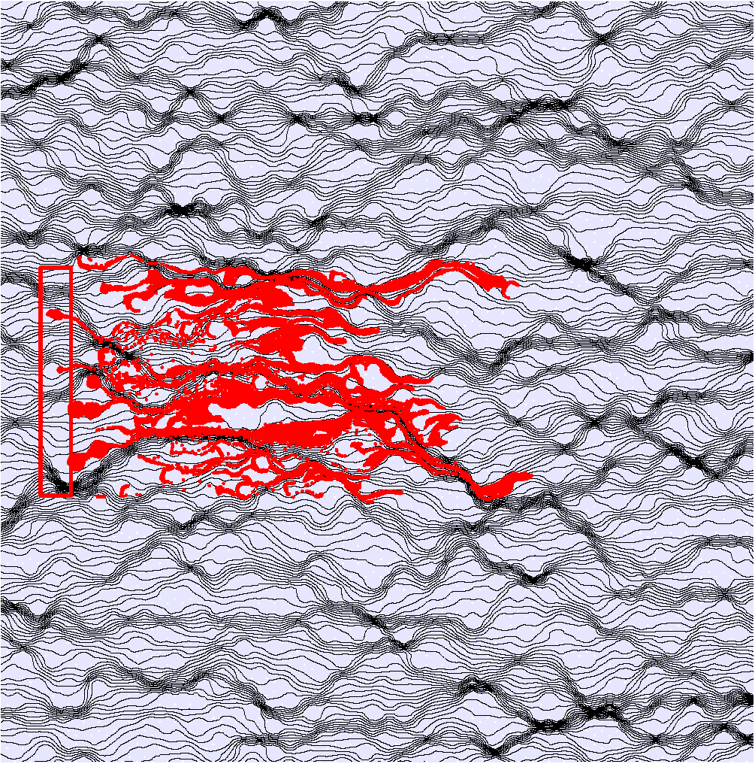
tU/I_{h}=22.5

Slide 29
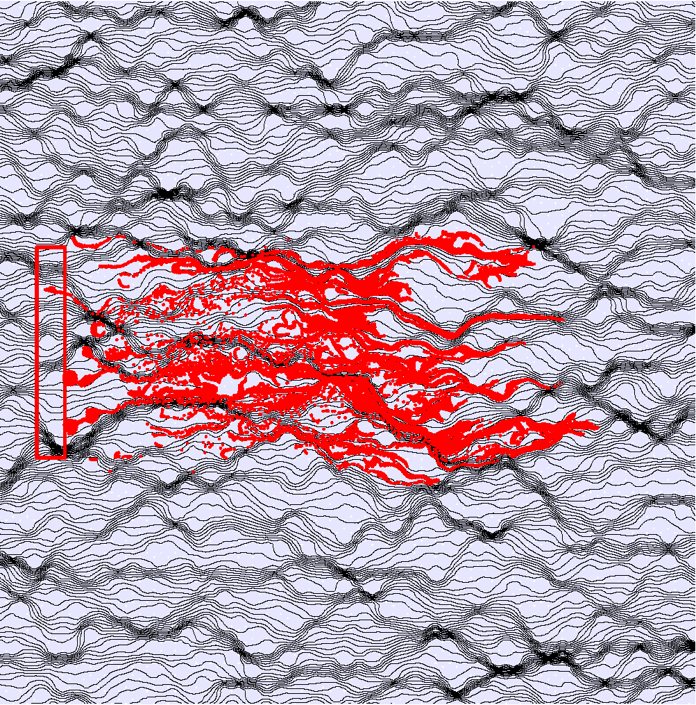
tU/I_{h}=30

Slide 30
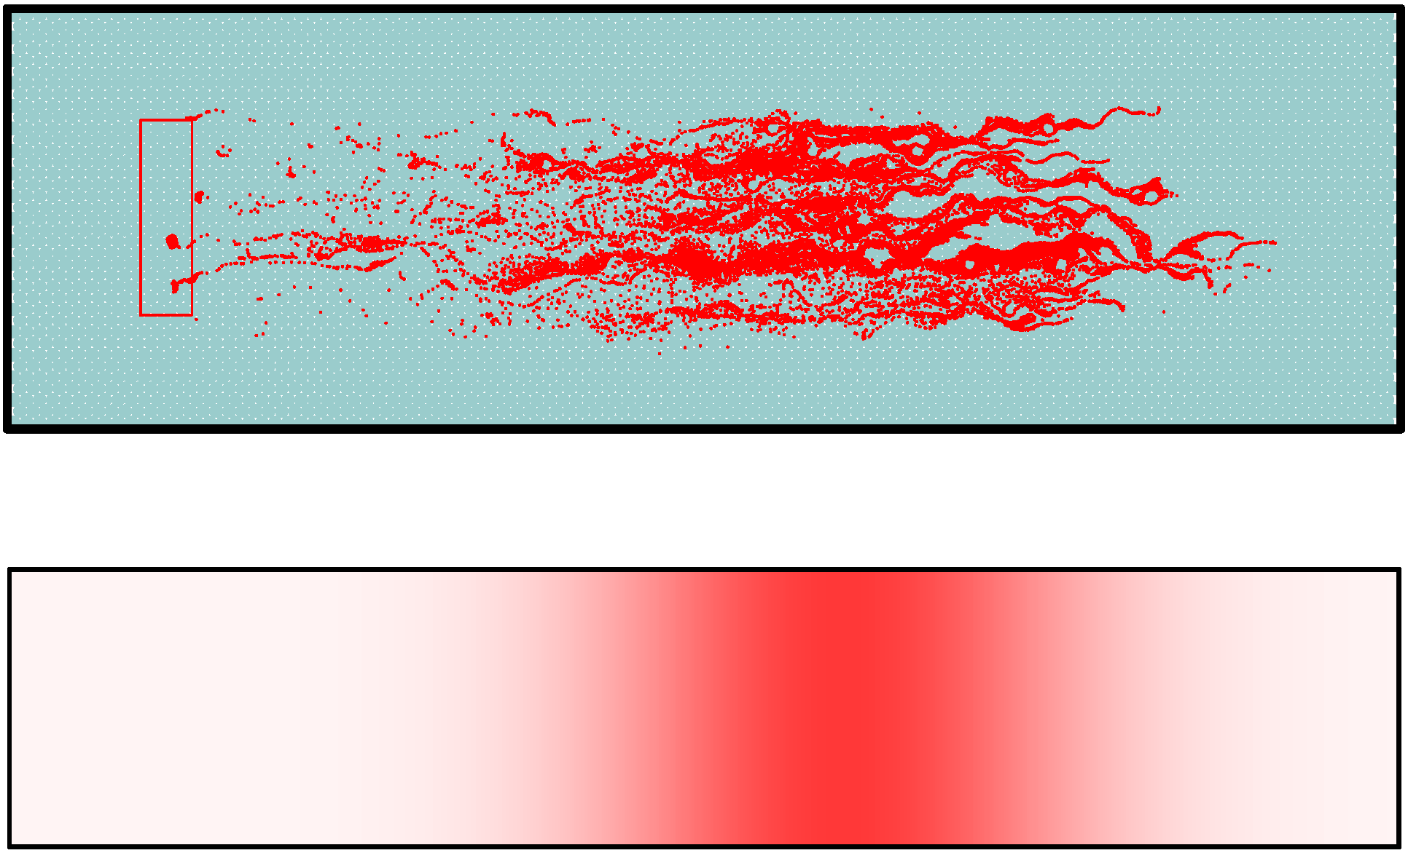

Slide 31
Lagrangean approach and quantification of transport
The initial solute body is regarded as made up from indivisible particles of mass ΔM. In the case of injection in a volume in the resident mode ΔM=C₀ΔV₀. For instantaneous injection in a plane ΔM/M₀ =m₀ ΔA₀ where M₀ is total mass and m₀ is (relative mass of solute)/area, i.e. ∫_{A₀}m₀dA₀ =1
In the resident mode m₀=const, in the flux proportional mode m₀(a)=[V_{x}(a)/U](ΔM/M₀ ΔA₀ ) where x=a is a coordinate in A₀ or V₀.

Slide 32
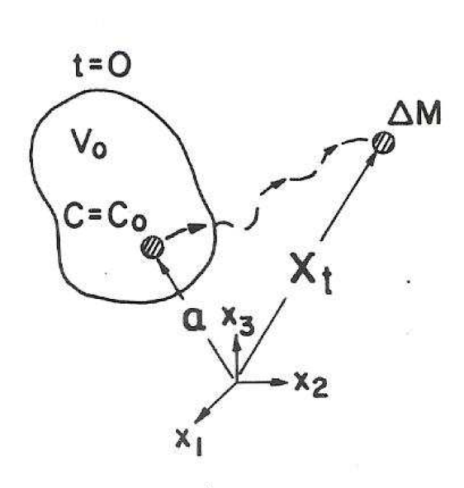
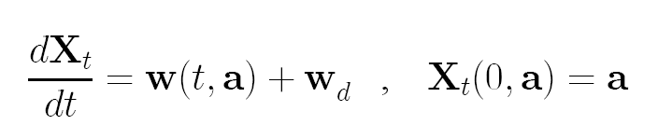
Trajectory definition
x=X_{t}(t,a) is the trajectory of a particle originating at x=a at t=0
The solute body at time t is made up from the ensemble of particles at X_{t}(t,a)
w is the Lagrangean fluid velocity w(t,a)=V[X_{t}(t,a)], w_{d} is a Wiener or Brownian motion diffusive velocity associated with local scale dispersion

Slide 33
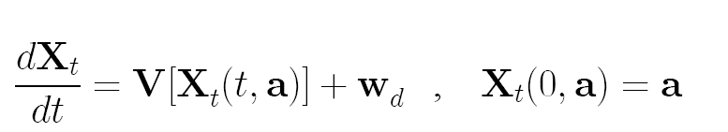
Solution for Lagrangean trajectories
Since the flow solution provides the Eulerian velocity V(x), X_{t} satisfies the stochastic integral equation
In the numerical approach known as particle tracking it becomes X_{t}(t+Δt,a)- X_{t}(t,a)=V[X_{t}(t,a)]Δt+ΔX_{d} where ΔX_{d} are random independent diffusive displacements associated with local dispersion. If local dispersion is neglected dX/dt=V[X(t,a)] is the trajectory of a fluid particle.

Slide 34
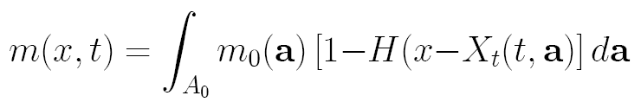
Quantification of plume transport
Here we focus on the global measure of mass arrival at a CP (control plane) at x, normal to the mean flow direction U(U,0,0) with A₀ at x=a_{x}=0
With M(x,t) the mass of solute which has crossed the CP at time t, m(x,t)=M/M₀ is known as the BTC (m>m(x,0)=0, m<m(x,∞)=1)
From the definition of X_{t}(t,a)
which connects the BTC with the trajectories

Slide 35
Analysis of transport by
Breakthrough Curves (BTC) (cont.)

Slide 36
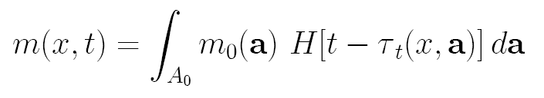
Analysis of transport by
Breakthrough Curves (BTC)
It is advantageous to rewrite the problem in terms of the travel time τ_{t}(x,a), the time for which the particle has crossed the CP which is related to X_{t} by x-X_{t}(τ_{t},a)=0, i.e. leading to
Since V is random, X_{t} and τ_{t} are random variables.
IP
CP
x

Slide 37

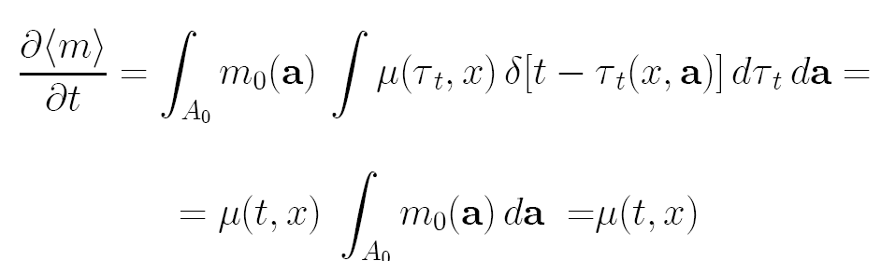
Derivation of the BTC
Let μ(τ_{t} ,x) be the PDF of τ_{t}(x,a); μ is independent of a due to the stationarity of the velocity field. Differentiating m, with
and ensemble averaging gives

Slide 38
Relation between the BTC and the travel time PDF
Thus, the relative expected value of the mass flux ∂(〈M〉/M₀)/∂t through the CP is equal to the PDF of travel time and therefore the BTC is the CDF (cumulative distribution function) of the travel time.
However, due to ergodicity of the plume 〈M〉≃M and ensemble and space averages of m can be exchanged.

Slide 39
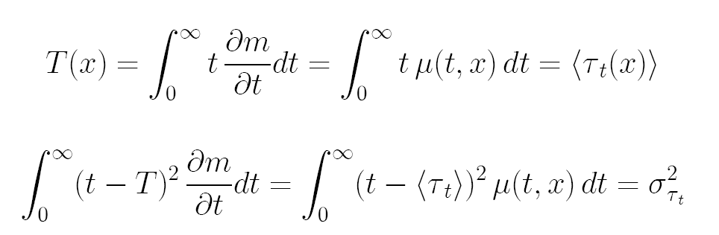
Temporal moments
The first two temporal moments of the BTC are defined therefore with the aid of μ as follows
and similarly for higher order moments.
It is seen that in order to determine the BTC it is necessary to derive the travel time PDF.

Slide 40
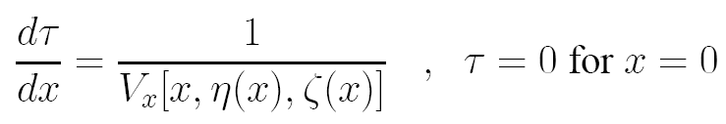


Approximate analytical solutions for weakly heterogeneous formations
The solution of the flow and transport problem at first order in σ_{Y}² (weak heterogeneity)
Analytical solutions were derived for the Eulerian velocity field V(x)=U+u(x).
For transport it was found that local pore-scale dispersion has a minor effect on the BTC. The advective travel time satisfies
where y=η(x),z=ζ(x) are the equations of the streamlines originating at the IP
with

Slide 41
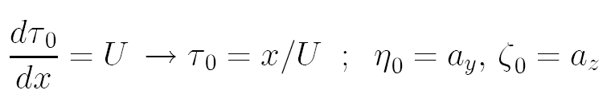
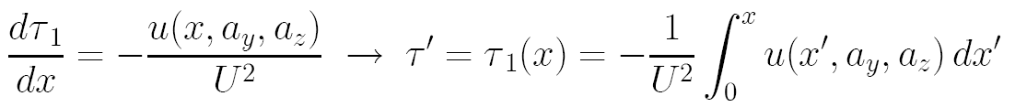
Approximate analytical solutions (cont.)
Expanding 1/V_{x}=1/(U+u_{x})=(1/U)[1-(u_{x}/U)+...] yields for τ=τ₀+τ₁..., η₀,ζ₀
i.e. at zero order streamlines are straight and 〈τ(x)〉=τ₀=x/U
u is a random variable of finite integral scale I_{u}~I_{h}

Slide 42
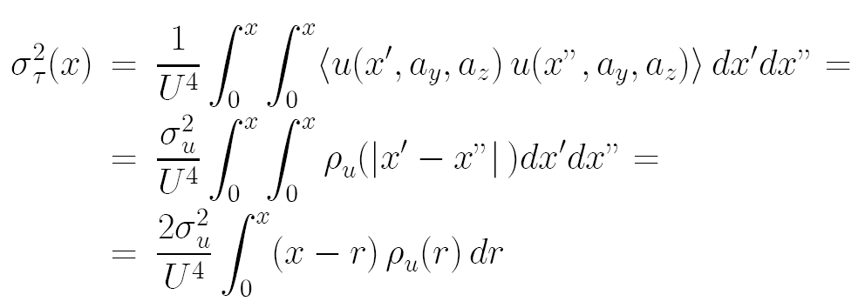
Travel time variance
Hence, for x>>I_{h}, τ=τ₀+τ₁ tends to a normal distribution μ(τ,x)=(2πσ_{τ}²)^{-1/2} exp[-(τ-x/U)²/(2σ_{τ}²)].
The first order variance is given for a stationary velocity field by
σ_{τ}²(x) grows from zero like σ_{u}²x²/U⁴ for x/I_{h}<<1 and tends asymptotically to the constant value σ_{τ}²→2σ_{u}²I_{u}x/U⁴ for x/I_{h}>1.

Slide 43
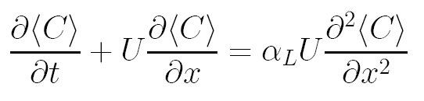
Transport equation
The mean concentration in transport of Gaussian travel time or trajectories distributions satisfies the ADE
where α_{L} is the macrodispersivity, characterizing spreading of solute due to heterogeneity α_{L}(x)→σ_{τ}²/(2U²x)=σ_{u}²I_{u}/U² for x/I_{h}>1.

Slide 44
Longitudinal macrodispersivity
Below the graphs displaying the dependence of α_{L}= σ_{τ}² /(2U²x) on x for formations of axisymmetric anisotropy of a few f=I_{v}/I_{h}

Slide 45

Longitudinal macrodispersivity (cont.)
It is seen that longitudinal macrodispersivity reaches the asymptotic constant value after a "setting" distance x/I_{h}~10. The asymptotic value does not depend on anisotropy and from the solution of the flow problem it is given by
For common values of σ_{Y}² and I_{h}, α_{L}>>α_{d,L}. For example for the Borden Site aquifer, σ_{Y}²=0.38, I_{h}=2.8m, α_{L}=0.36 m whereas α_{d,L}≅0.001 m

Slide 46
Longitudinal macrodispersivity (cont.)
Numerical simulations and field tests have showed that the first order approximation is quite accurate for σ_{Y}²≤1, making it useful for many aquifers of weak heterogeneity.

Slide 47
Transport in strongly heterogeneous formations: A few unresolved issues
Large dispersivities (scale effect?)
Large “setting times”, non-Fickian stage (non-Fickian transport?)
Non-Gaussian breakthrough curve (ADE solution / Gaussian model not appropriate?)
Anomalous transport?

Slide 48
Novel Lagrangian, travel-time based approach to solute transport
Motivations:
Overcome the limitations of the weak-heterogeneity assumption
Make use of detailed numerical simulations as a “virtual” laboratory for understanding processes
Develop a simplified analytical framework
  simplified, closed form results;
  insight into main transport mechanisms

Slide 49
Analysis of transport by
Breakthrough Curves (BTC)
Better insight into physical processes, more complete information
Link with travel time pdf
Dispersivity analysis not much reliable (or significant)

Slide 50
Relation with travel time distribution
For an ergodic plume, µ tends to the probability density function (pdf) f(τ;x) of the travel time of a solute particle between the injection plane and the control plane
IP
CP
x

Slide 51
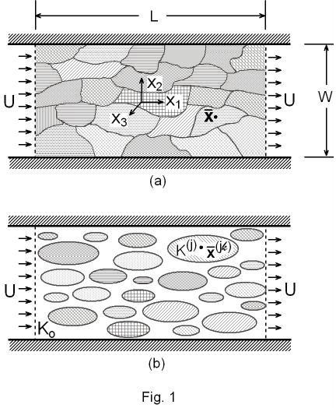
The model of the medium structure (1)
Heterogeneity is represented as a collection of elements located at random with random independent K
Since the information is only statistical the elements centroids and conductivity K are regarded as independent random variables
Mean uniform flow U is assumed at infinity

Slide 52
The model of the medium structure (2)
A fine scale realization of the structure may be achieved by (a) a dense grid-like set of small cubical elements of K correlated values
This is replaced by (b) a set of large blocks of uncorrelated K values
For simplicity they replaced by densely packed spherical elements
In the Self-Consistent approximation flow and transport are solved by regarding each spherical element as isolated one (e) submerged in the matrix of effective conductivity
Extension to cubical elements is possible

Slide 53
Numerical solutions of flow and transport by the Analytical Element Method
(Strack, Jankovic)
The method is very efficient, with arbitrary precision and degree of heterogeneity
The method is gridless
Flow and transport solution can be solved by parallel computer

Slide 54
The self-consistent model
A dilute medium of volume density n<<1: inclusions are widely separated and velocity field is superimposition of those of isolated inclusions surrounded by the matrix Applicable to any σ_{Y}² !
Kef (the background effective conductivity) incorporates the effect of surrounding inclusions. Intuitive reasoning: each inclusion is surrounded by a layer of inclusions of different K.
The flow and transport solution is obtained by superposition of particular solutions for isolated inclusions
We assume that the spherical inclusions are characterized by a (unique) radius R, uncorrelated with the hydraulic conductivity

Slide 55
The self-consistent model
Requirements:
The velocity field for an isolated inclusion (exterior and interior flow);
The travel time distribution for an isolated inclusion;
The particle travel time cannot in general be evaluated in a closed-form expression, and it needs a numerical quadrature;
Further numerical quadratures are needed for the calculation of the dispersivity and the breakthrough curve.

Slide 56
Determination of K_{ef}
Flow: application to determining K_{ef} .
K_{ef} : value of K₀ for which <V>=U, i.e. ∫u(x)dx= ∫u_{in}(x) dx=<u_{in}>=0 velocity perturbations cancel each other.
For a distribution defined by f(κ) with κ=K/K₀
(2D)
(3D)

Slide 57
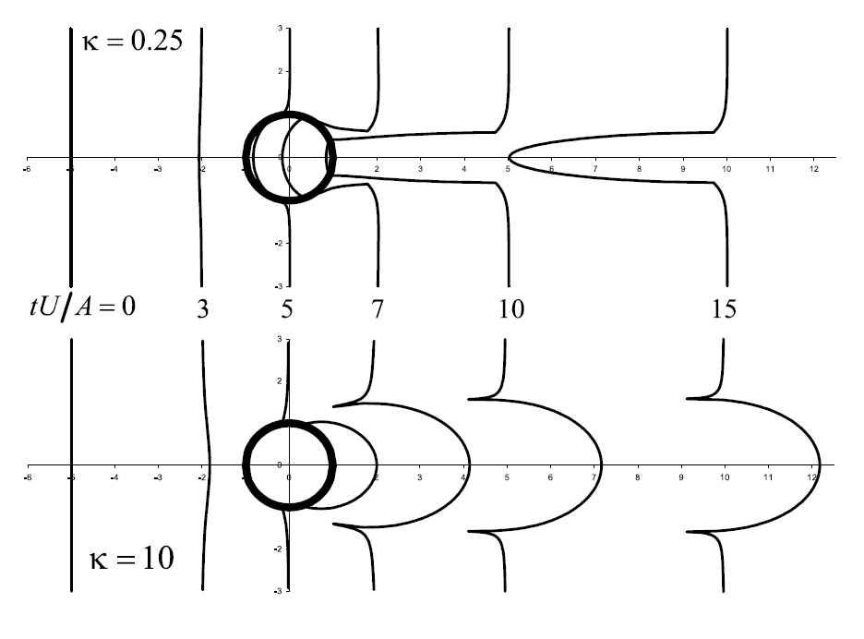
Transport past a single inclusion
A thin plume is injected upstream the inclusion. By integration along streamlines, its spatial deformation is quantified by X(t,a ) or by the travel time τ(x,a ) to control plane at x. Illustration for two values of κ
It is seen that the residual X’(t,a ) = X(t,a ) –U t stabilizes after a travel distance of a few A=R.

Slide 58
Main features: “Slow” transport
V_{in} /U=3κ/2 → 0 and residence time →∞ ;
mass flux through inclusion ~A_{wake} U= AV_{in} → 0
the proportion of inclusions of conductivity κ=K/Kef is f(κ) dκ= f(Y) dY which increases with σ_{Y}²

Slide 59
Main features: “Fast” transport
For κ→ ∞, V_{in} /U→3 due to the constraining effect of the matrix.
Residence time τ_{Rmax} → -3R/U and mass flux ~A_{wake} =3A

Slide 60
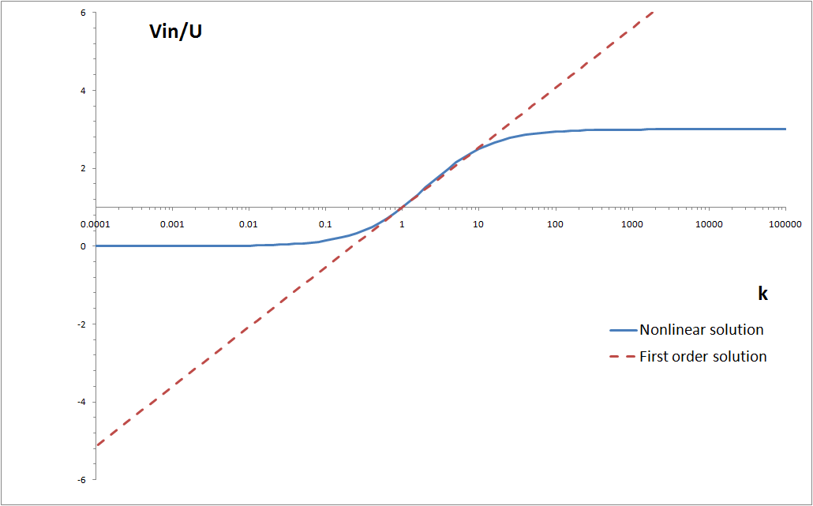
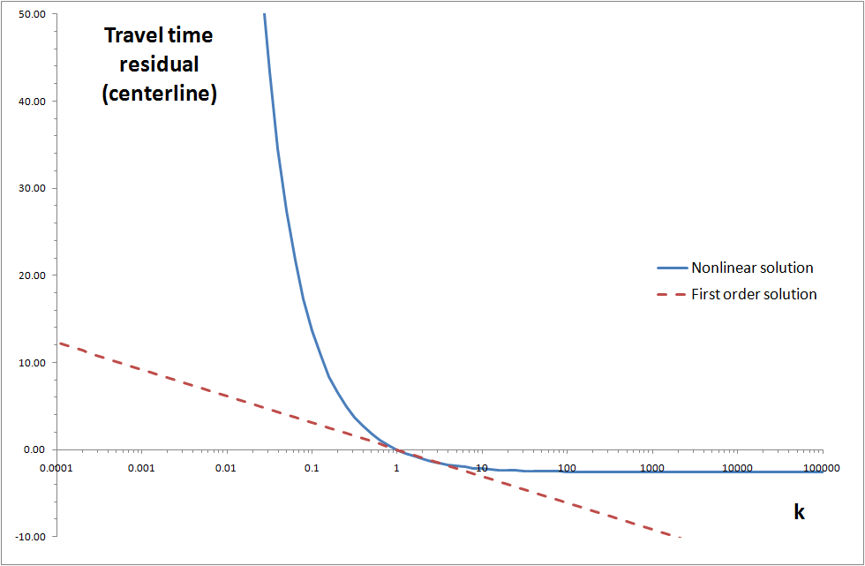
interior velocity V_{i} residual travel time

Slide 61
Solute flux distribution:
Approximate semi-analytical solution
Under the ergodic assumption, the solute flux is equal to the travel time distribution
Travel time is considered as the sum of independent contributions, deriving from the sequence of inclusions encountered by the solute particle
Assumptions:
Isotropic K
Flux proportional injection mode

Slide 62
Solute flux distribution:
Approximate semi-analytical solution
The travel time distribution derives from the multiple convolution of a kernel
PARAMETERS (Lognormal Y):
Mean velocity U
Logconductivity Integral scale I
Logconductivity variance
Inclusions density n

Slide 63
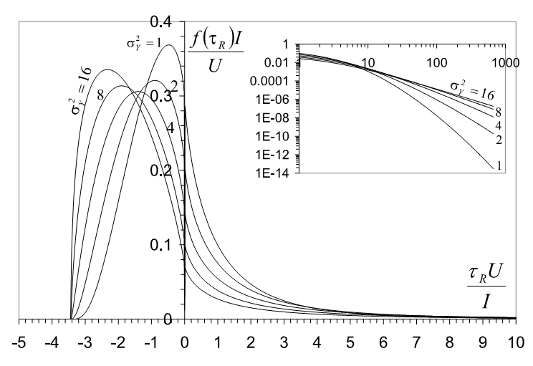
The BTC kernel
The pdf becomes more and more tailed for increasing variance;
Fast, preferential flow emerges;
Deviations from the inverse-Gaussian distribution become more significant

Slide 64
Analysis of the BTC: Gaussianity
For moderate heterogeneity the solute flux rapidly converges toward Gaussianity
Convergence to Gauss is extremely slow for highly heterogeneous formations
Early and late arrivals characterize BTC
Solute hold-up in the low-K zones dominates the long and persistent tail

Slide 65
Analysis of BTC: Gaussianity (2)

Slide 66
The BTC tail: power-law behaviour?
Apparent power- law behaviour for strong heterogeneity.
Slope>=2 for about 1.5-2 logscales
A power-law tail does not necessarily imply anomalous transport or K features

Slide 67
Comparison with Numerical Simulations

Slide 68
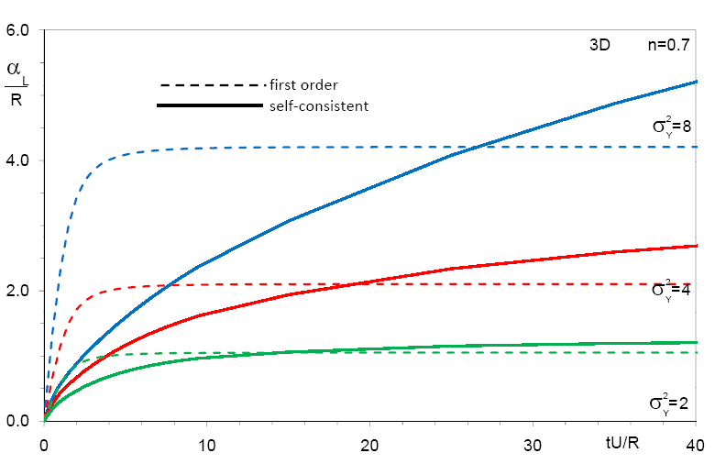
Longitudinal dispersivity
- The solution for HHF displays increasing α_{L} for considerable travel time : apparently anomalous (though theoretically Fickian for tU/I→∞); impact of the BTC tail (low-K elements)
- The first-order solution underestimates α_{L} and levels off after a short “setting time”

Slide 69
Comparison with 2D simulations
Comparison with Dreuzy et al (2007) : accurate finite difference 2D solution
for a multi-Gaussian Logconductivity structure.
Comment:
only in 2007 accurate NS (numerical simulations) were carried out for highly heterogeneous formation and a large flow domain, but for 2D !
impact of the BTC tail (low-K elements)
de Dreuzy, J.-R., A. Beaudoin, and J. Erhel (2007), Asymptotic dispersion in 2D heterogeneous porous media determined by parallel numerical simulations, Water Resour. Res., 43, W10439, doi:10.1029/2006WR005394

Slide 70
Conclusions
The solute flux (BTC) is derived through a simplified model based on the “self-consistent” approximation
High heterogeneity results in a skewed BTC, with fast and slow flow contributions; the fast arrivals distribution tends to stabilize with σ_{Y}, the tail always grows
The tail depends on both ergodicity (σ_{Y} , injection area, CP distance) and detection limit
Ergodicity restrictions become severe with increasing σ_{Y}: tail cutoff and plume size

Slide 71
Conclusions (2)
Macrodispersivity is largely determined by the BTC tail; hence, it is not always a good descriptor of transport processes
The Gaussian solution is valid only for weak heterogeneity or extremely large time
Transport may seem anomalous, but genuine anomalous transport occurs under restricted conditions; it is difficult to distinguish between genuine anomalous and tailed-but-normal transport.
The higher-order statistical structure of K plays a crucial role when in presence of high heterogeneity

Slide 72
References
I. Janković, A. Fiori and G. Dagan, The Impact of Local Diffusion on Longitudinal Macrodispersivity and its Major Effect upon Anomalous Transport in Highly Heterogeneous Aquifers, Advances in Water Resources, doi: 10.1016/j.advwatres.2008.08.012, 2008
de Dreuzy, J.R., A. Beaudoin and J. Erhel, Asymptotic dispersion in 2D heterogenepus porous media determined by parallel numerical simulations, Water. Res. Res., 43, doi:10.1026/2006WR005394, 2007
A. Fiori, I. Janković, G. Dagan, and V. Cvetković, Ergodic Transport through Aquifers of Non-Gaussian Log-Conductivity Distribution and Occurrence of Anomalous Behavior, Water Resources Research, 43, W09407, doi:10.1029/2007WR005976, 2007
I. Janković, A. Fiori and G. Dagan, Modeling Flow and Transport in Highly Heterogeneous Three-Dimensional Aquifers: Ergodicity, Gaussianity and Anomalous Behavior. Part 1: Conceptual Issues and Numerical Simulations, Water Resources Research, 42, W06D12, doi:10.1029/2005WR004734, 2006
A. Fiori, I. Janković and G. Dagan, Modeling Flow and Transport in Highly Heterogeneous Three-Dimensional Aquifers: Ergodicity, Gaussianity and Anomalous Behavior. Part 2: Approximate Semi-Analytical Solution, Water Resources Research, 42, W06D12, doi:10.1029/2005WR004752, 2006
I. Janković, A. Fiori, R. Suribhatla and G. Dagan, Identification of Heterogeneous Aquifer Transmissivity Using an AE-Based Method, Ground Water, 44(1), 62-71, 2006
A. Fiori, I. Janković and G. Dagan, The Effective Conductivity of Heterogeneous Multiphase Media with Circular Inclusions, Physical Review Letters, 94, 224502, 2005
A. Fiori and I. Janković, Can we Determine the Transverse Macrodispersivity by Using the Method of Moments?, Advances in Water Resources, 28, 589-599, 2005
G. Dagan, A. Fiori and I. Janković, Transmissivity and Head Covariances for Flow in Highly Heterogeneous Aquifers, Journal of Hydrology, 294(1-3), 39-56, 2004
G. Dagan, A. Fiori and I. Janković, Flow and Transport in Highly Heterogeneous Formations, Part 1. Conceptual Framework and Validity of First-Order Approximations, Water Resources Research, 39(9), 1268, 10.1029/2002WR001717, 2003
A. Fiori, I. Janković and G. Dagan, Flow and Transport in Highly Heterogeneous Formations, Part 2. Semi-Analytical Results for Isotropic Media, Water Resources Research, 39(9), 1269, 10.1029/2002WR001719, 2003
I. Janković, A. Fiori and G. Dagan, Flow and Transport in Highly Heterogeneous Formations, Part 3. Numerical Simulations and Comparison with Theoretical Results, Water Resources Research, 39(9), 1270, 10.1029/2002WR001721, 2003
A. Fiori, I. Janković and G. Dagan, Flow and Transport Through Two-Dimensional Isotropic Media of Binary Conductivity Distribution. Part 1: Numerical Methodology and Semi-Analytical Solutions, Stochastic Environmental Research and Risk Assessment (SERRA), 17(6), 370-383, 2003
I. Janković, A. Fiori and G. Dagan , Flow and Transport Through Two-Dimensional Isotropic Media of Binary Conductivity Distribution. Part 2: Numerical Simulations and Comparison with Theoretical Results, Stochastic Environmental Research and Risk Assessment (SERRA), 17(6), 384-393, 2003
I. Janković, A. Fiori and G. Dagan, Effective Conductivity of an Isotropic Heterogeneous Medium of Lognormal Conductivity Distribution, Multiscale Modeling, Analysis, and Simulation (MMAS) - a SIAM Interdisciplinary Journal, 1(1), 40-56, 2003
P. Salandin and V. Fiorotto, Solute transport in highly heterogeneous aquifers, Water Res. Res, 5(34), 949-961,1998

