Slide 1



CO₂-migration:
Effects and upscaling of caprock topography
Sarah E. Gasda¹, Halvor M. Nilsen², and Helge K. Dahle³
¹Center for Integrated Petroleum Research, Uni Research, Bergen
²SINTEF, IKT, Oslo
³Department of Mathematics, University of Bergen
RICAM, October 2-6. 2011

Slide 2
Acknowledgments:
Collaborators:
Paulo Herrera, University of Chile
William G. Gray, University of North Carolina
Knut-A. Lie, SINTEF ICT, Oslo
Jan M. Nordbotten, University of bergen
This research was sponsored through Project no. 178013 (MatMoRA)
funded by the Research Council of Norway, Statoil, and Norske Shell

Slide 3
Overview
Motivation
VE-upscaling
Importance of caprock topography
Effective models for caprock topography
Discussion

Slide 4
Motivation
Long term security of CO₂ can only be assessed from simulations
Because of complexity of processes and geology we need simplified models and upscaling techniques

Slide 5
Motivation
LEAKED
Long term security of CO₂ can only be assessed from simulations
Because of complexity of processes and geology we need simplified models and upscaling techniques
MOBILE
TRAPPED
Need to differentiate between structurally trapped and mobile CO₂ which has the potential to leak

Slide 6
Vertical Equilibrium
Dupuit [1863] assumption in groundwater flow
Assumption of Vertical equilibrium allows partial integration of multiphase flow equations (Dietz [1953], Coats et al [1967, 1971], Martin [1968], Lake [1989], Yortsos [1995] )
VE-module implemented in Eclipse in the early eighties to study gas flow in the Troll-field
VE-formulations have recently become popular to investigate CO₂-storage efficiency in saline aquifers,e.g., (Nordbotten et al [2006, 2010], Hesse et al [2008], Gasda et al [2008, 2009,2011], Juanes et al [ 2008, 2009])
Because of large density difference between supercritical CO₂ and brine, and large lateral to vertical aspect ratio, flow will segregate rapidly to establish a vertical equilibrium in pressure

Slide 7
Simplified Model
Mobile CO₂
Assumptions:
Gravity segregation occurs on a fast time scale
Capillary and gravity forces are balanced
Fluid pressures are in vertical equilibrium:
Residual CO₂
Dissolved CO₂
Scales:
Time:
Lateral length:
Vertical length:

Slide 8
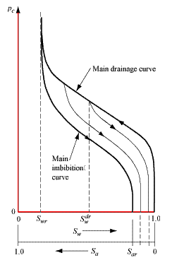
VE-upscaling:
Fine scale:

Slide 9
Assumptions:
VE-upscaling:
Fine scale:

Slide 10
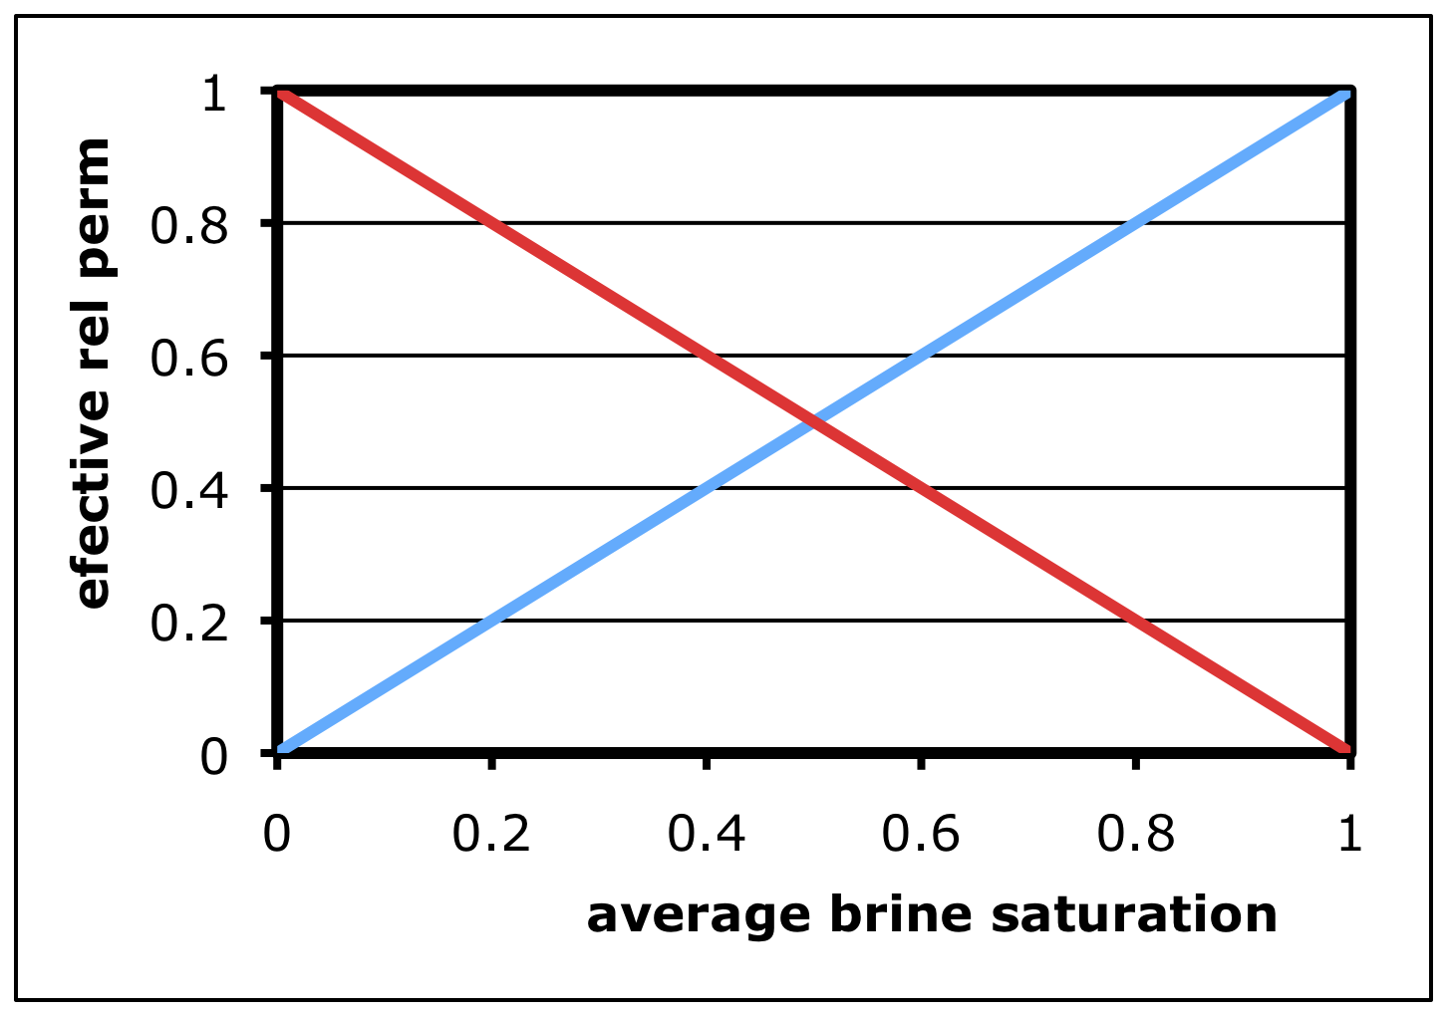
Assumptions:
VE-upscaling:
Fine scale:
Reconstruction:

Slide 11
Assumptions:
VE-upscaling:
Fine scale:
Coarse scale:
Reconstruction:

Slide 12
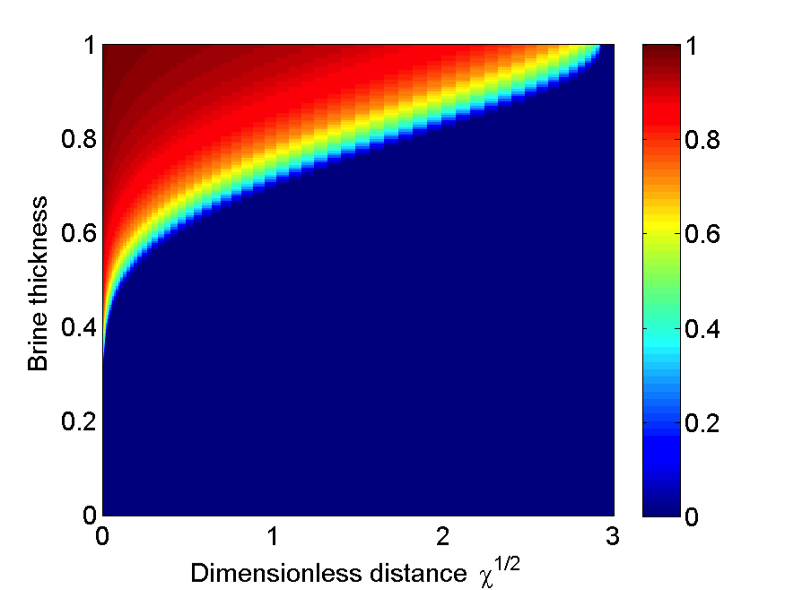
Example calculation: Capillary fringe
Entry pressure:
Bond number:

Slide 13
Example calculation: Capillary fringe
VE-assumption:
Entry pressure:
Bond number:

Slide 14
Example calculation: Capillary fringe
VE-assumption:
Reconstruct:
Entry pressure:
Bond number:

Slide 15
Example calculation: Capillary fringe
VE-assumption:
Reconstruct:
Upscale:
Entry pressure:
Bond number:

Slide 16
Example calculation: Capillary fringe
VE-assumption:
Reconstruct:
Upscale:
Entry pressure:
Bond number:
Sharp interface:

Slide 17
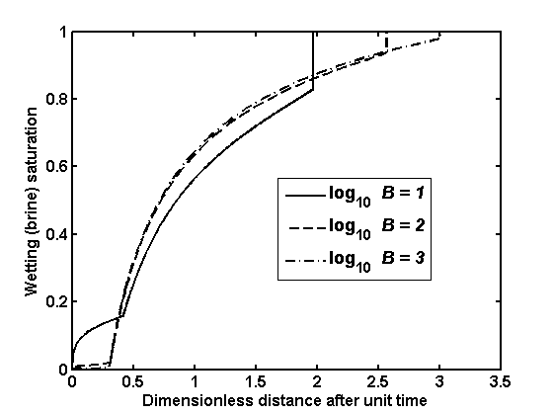
Example calculation: Capillary fringe

Slide 18
Analysis of dimensionless groups
Dimensionless groups:
Horizontal to vertical aspect ratio:
Inverse bond number:
Timescale to establish capillary fringe:
Timescale associated with vertical segregation:
Time scale associated with horizontal flow:

Slide 19
Analysis of dimensionless groups
Vertical models are valid if (Yortsos 95):
Vertically segregated flow if:
Capillary fringe established if:
Sharp interface applicable if:

Slide 20
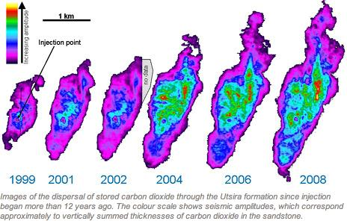
Structural Trapping
A
Traps mobile CO₂ in domes and structural traps,
Slows upslope migration,
Decreases time to plume stabilization.
H
ω
h_{max}
L
θ

Slide 21
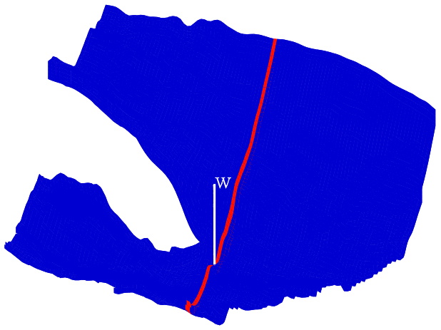
Comparison 3D with VE
Example calculation: Cross-section of the Johansen formation

Slide 22
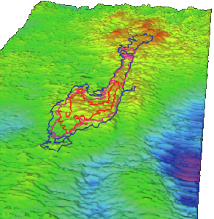
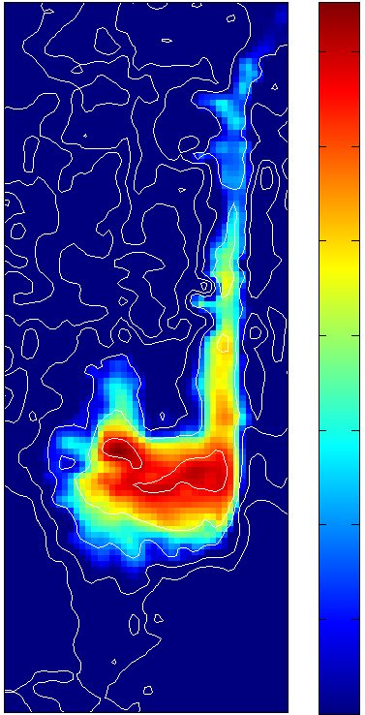
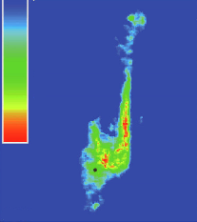
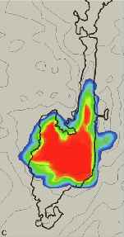
Matching seismic data
Seismic data 2006
3D simulation
(tough2)
VE-simulation
Chadwick, Noy, Arts & Eiken: Latest time-lapse seismic data from Sleipner yield new insights into CO₂-plume development, Energy Procedia (2009), 2103--2110.

Slide 23
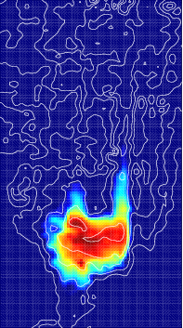
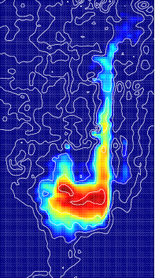
Sensitivity to Fluid/Rock Properties
VE model, Chadwick et al data
VE model, modified data (higher perm,
lower porosity, lower density)
7 years
7 years
Utsira top layer

Slide 24
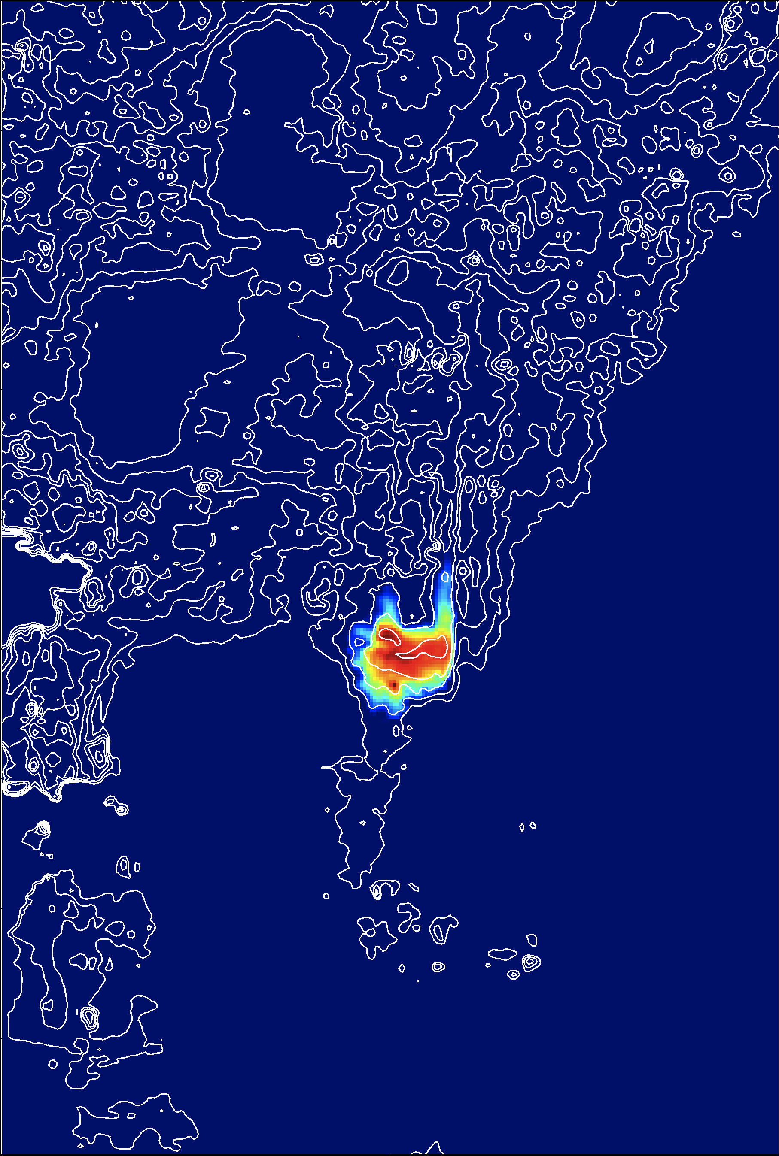
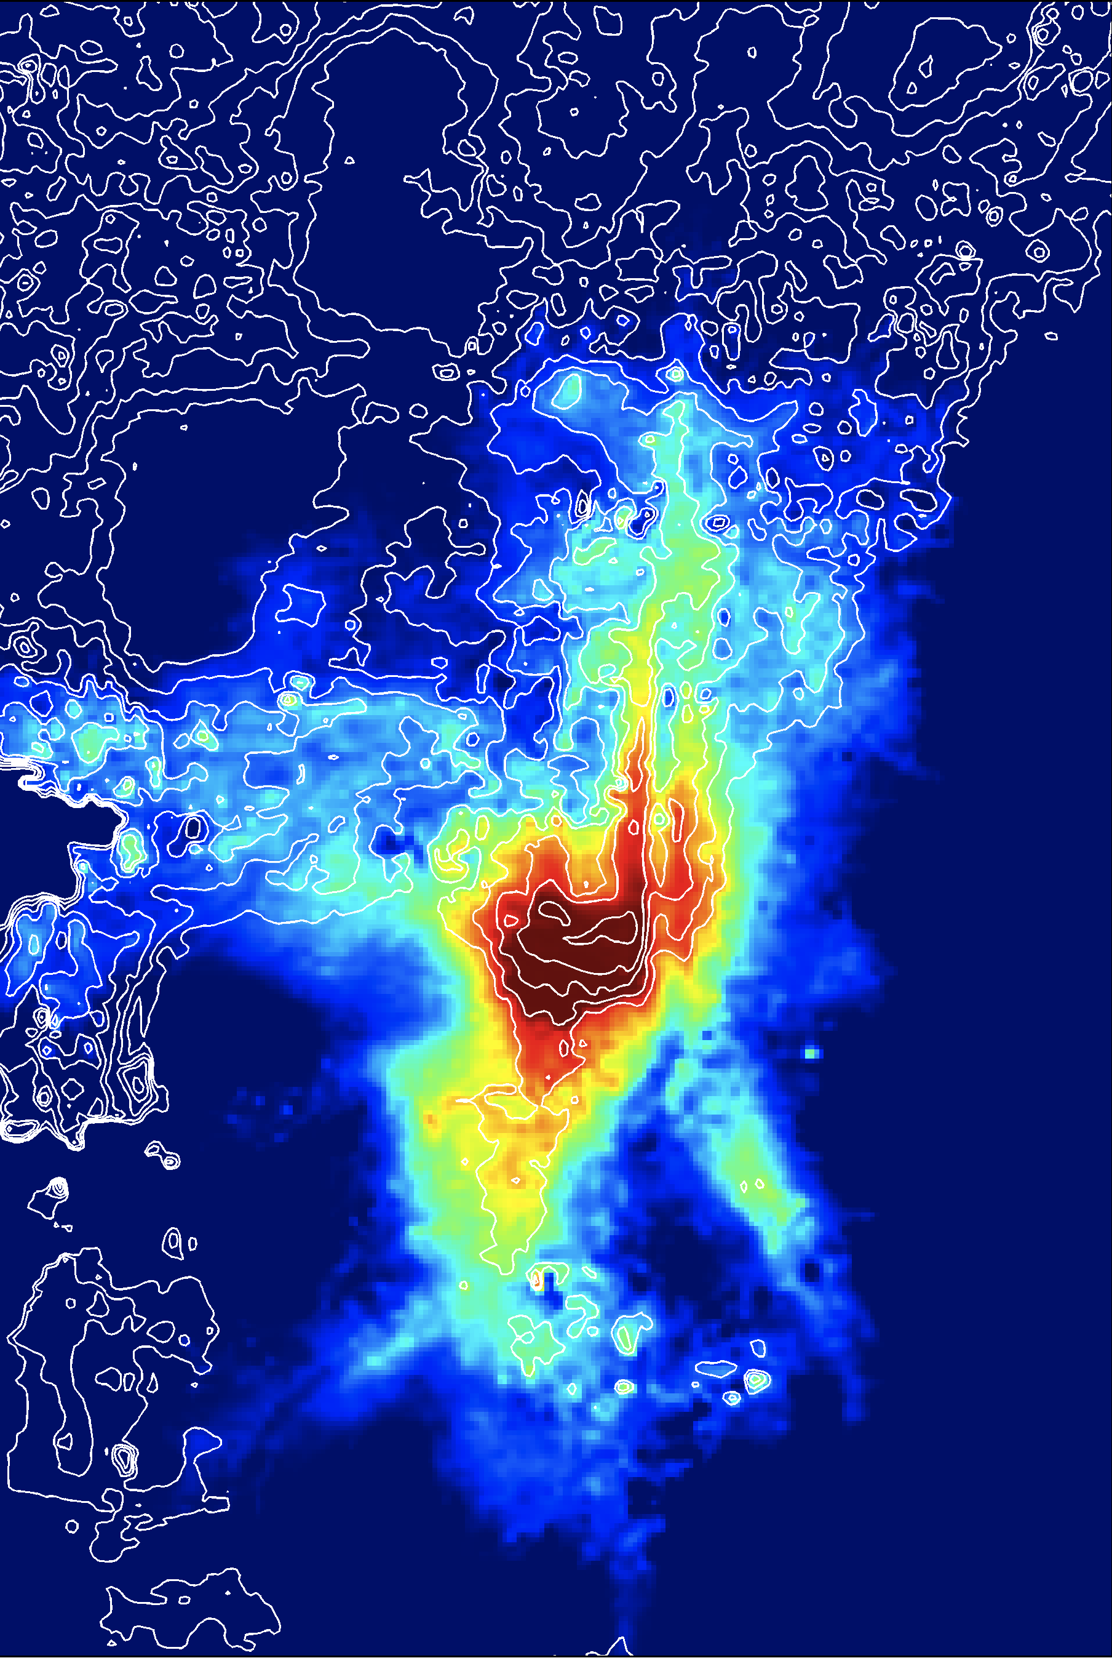
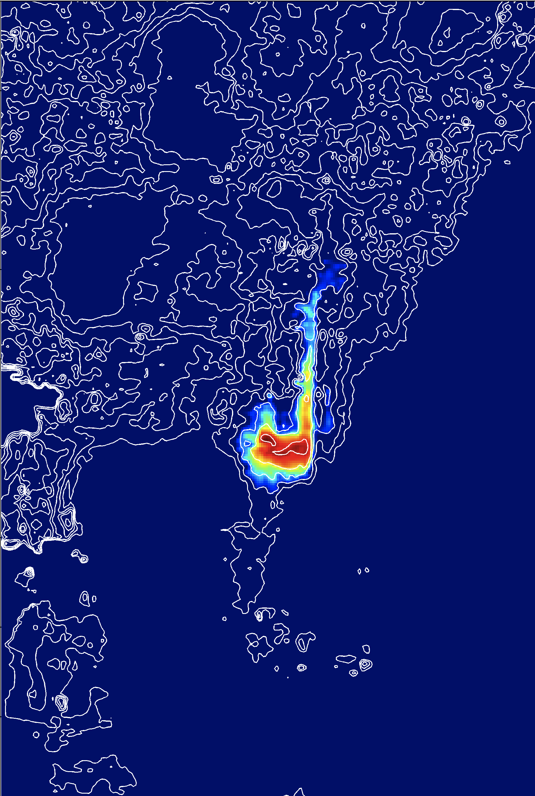
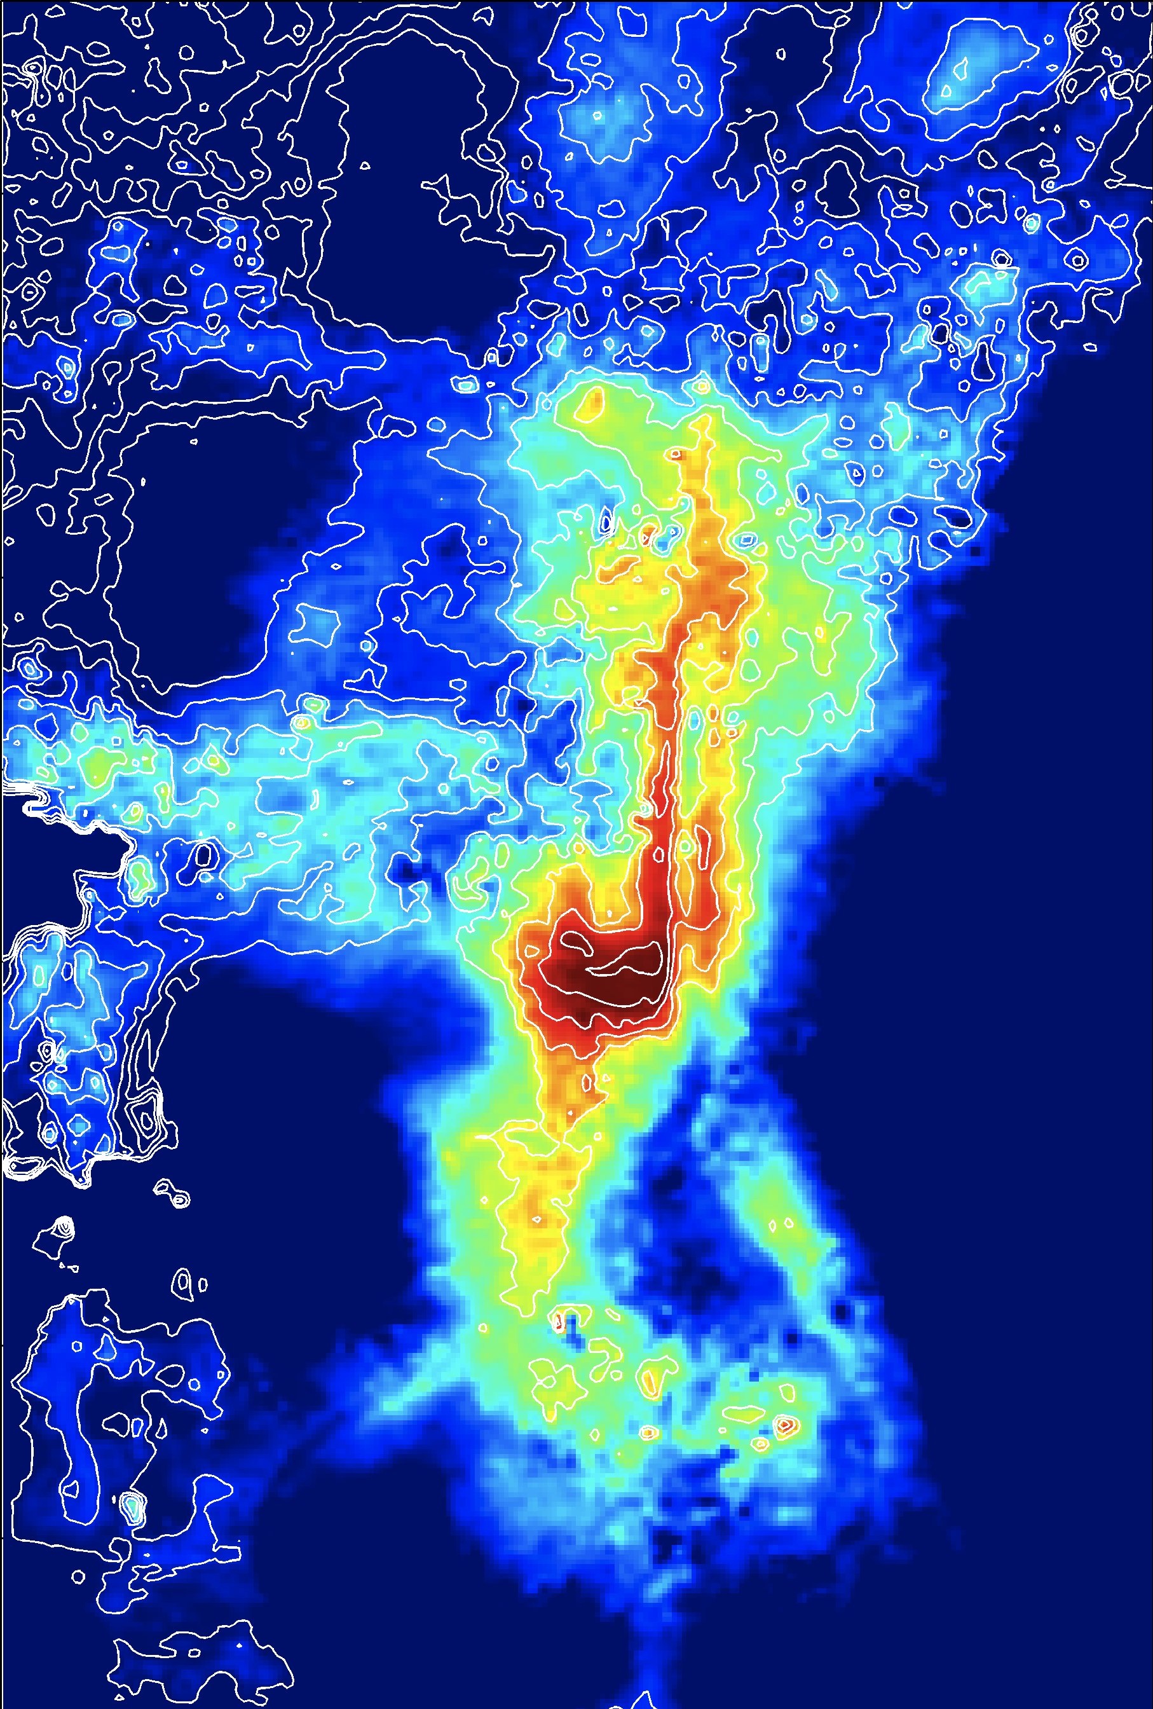
Sensitivity to Fluid/Rock Properties
VE model, Chadwick et al data
VE model, modified data (higher perm,
lower porosity, lower density)
7 years
30 years
7 years
30 years
Utsira top layer 6000 meters X 9000 meters

Slide 25
Intermediate summary/observations:
CO₂ will (initially) form a thin plume under the caprock which spreads laterally
  High resolution in the vertical dimension needed
  VE-models give infinite vertical resolution
The plume is very sensitive to fluid parameters and rock properties (Utsira case)
  Fast methods needed to determine the likely plume distribution
  Early time behavior is important for predicting late time migration
Questions:
Is subscale topography (rugosity) important?
How can it be captured by effective models?
How should it be parameterized?

Slide 26
Structural Trapping
(subscale…)
A
Traps mobile CO₂ in domes and structural traps,
Slows upslope migration,
Decreases time to plume stabilization.
H
ω
h_{max}
Numerical Simulations
Characterize undulations in caprock as sinusoidal functions.
Vary amplitude and wavelength in 2D and 3D VE simulations.
Comparison with Eclipse 3D and VE simulations.
L
θ
Gray, Herrera, Gasda and Dahle. Derivation Of Vertical Equilibrium Models For CO₂ Migration From Pore Scale Equations. Journal of Numerical Analysis and Modeling, in press.

Slide 27
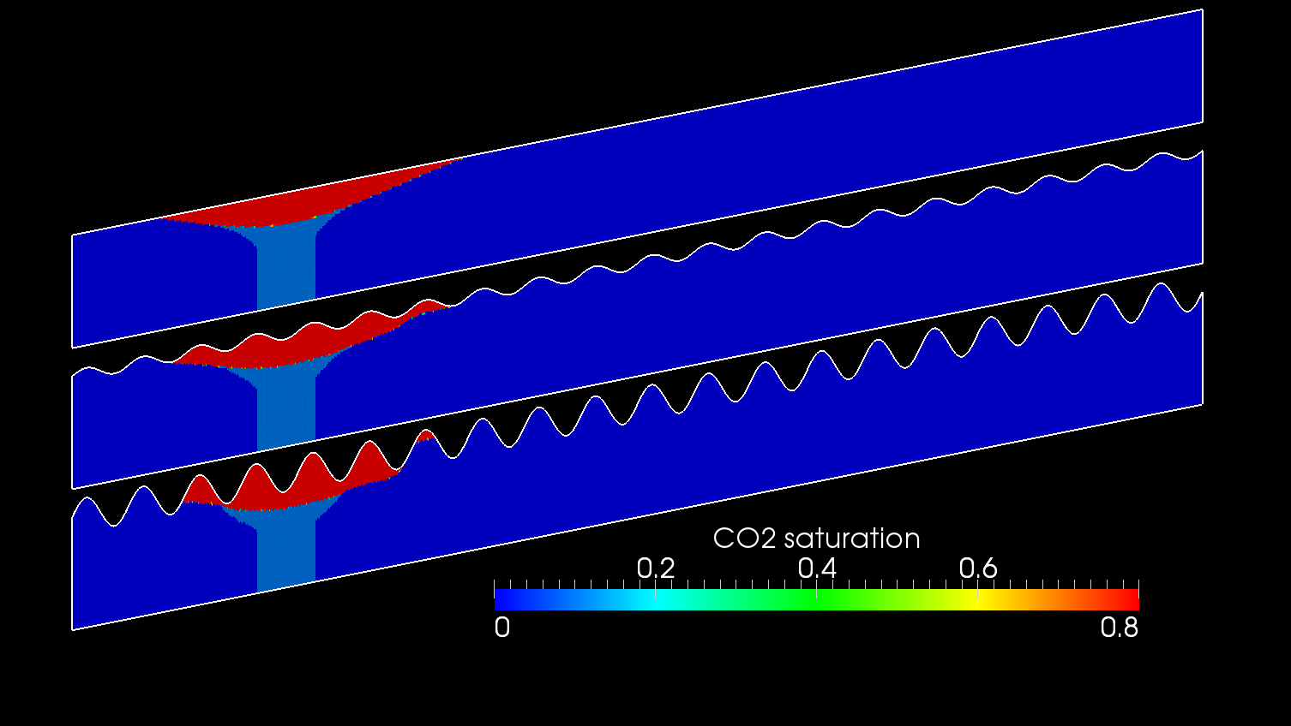
Migration under sinusoidal caprock (Eclipse simulation)
100 years
a=0
a=0.05
a=0.15

Slide 28
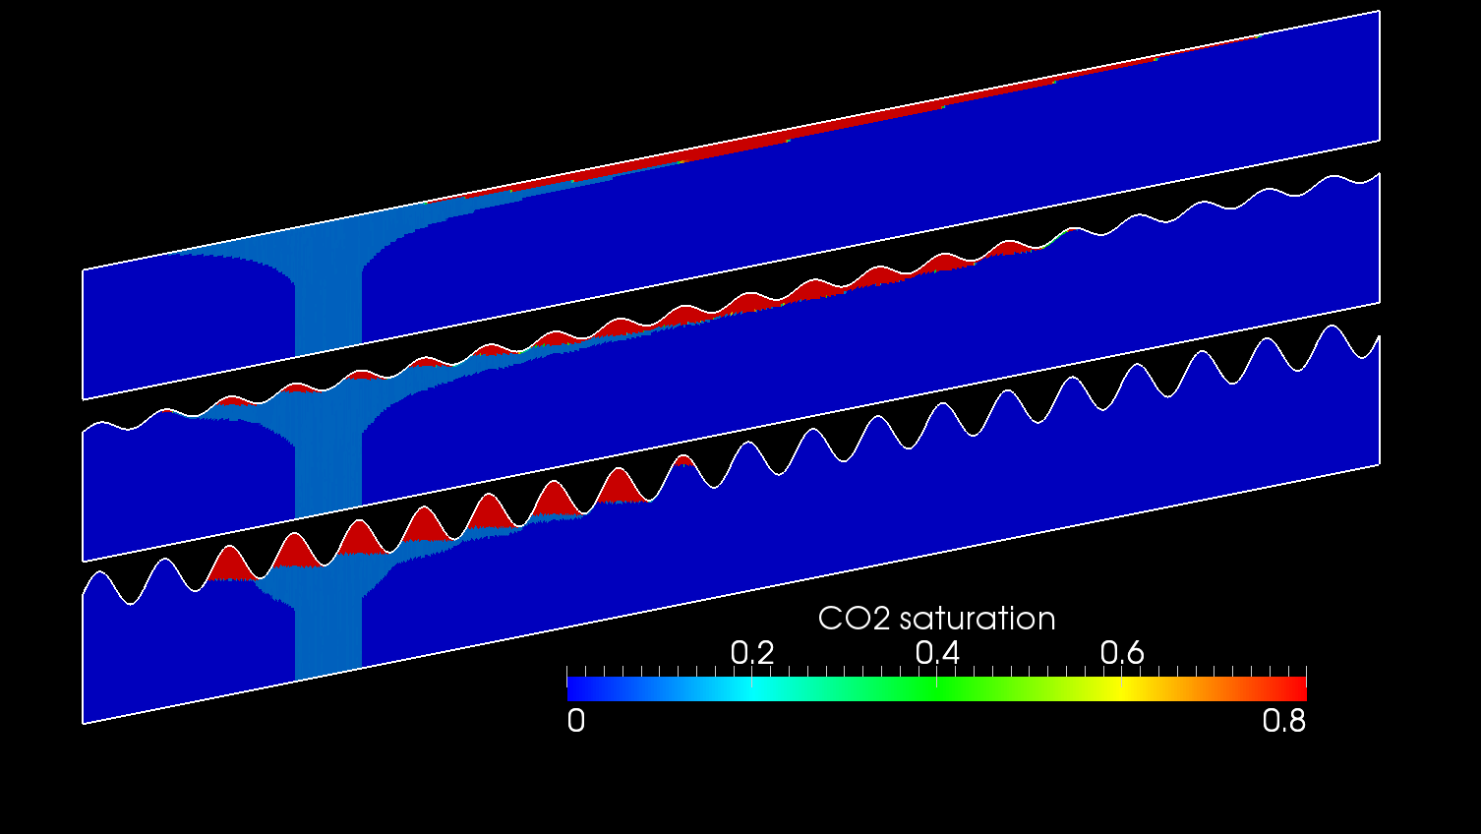
Migration under sinusoidal caprock (Eclipse simulation)
1300 years
a=0
a=0.05
a=0.15

Slide 29
Migration under sinusoidal caprock (Eclipse simulation)
1300 years
a=0
a=0.05
a=0.15
Estimated position of leading tip

Slide 30
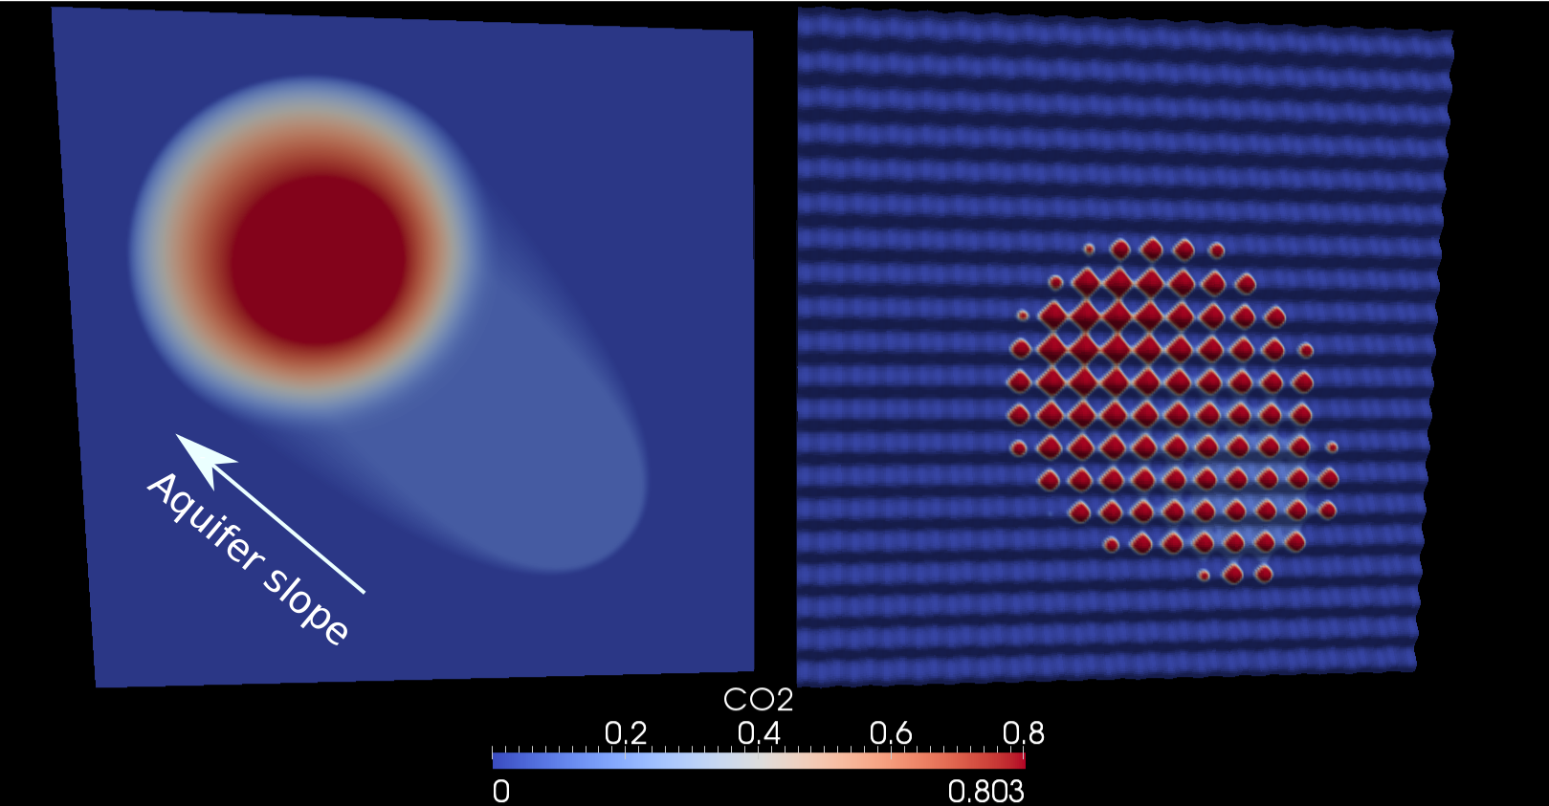
Migration under sinusoidal caprock (Eclipse simulation)
a=0.05
1300 years
a=0
a=0.05
a=0.15
Flat aquifer
Sinusoidal aquifer
1000 years

Slide 31
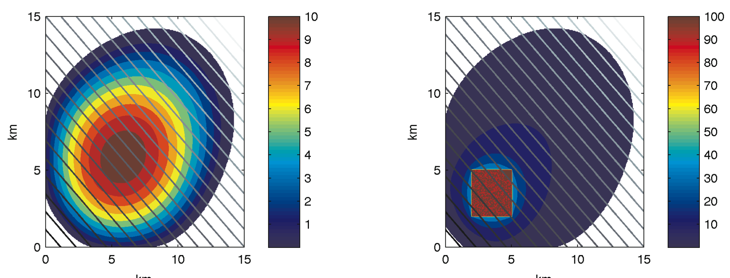
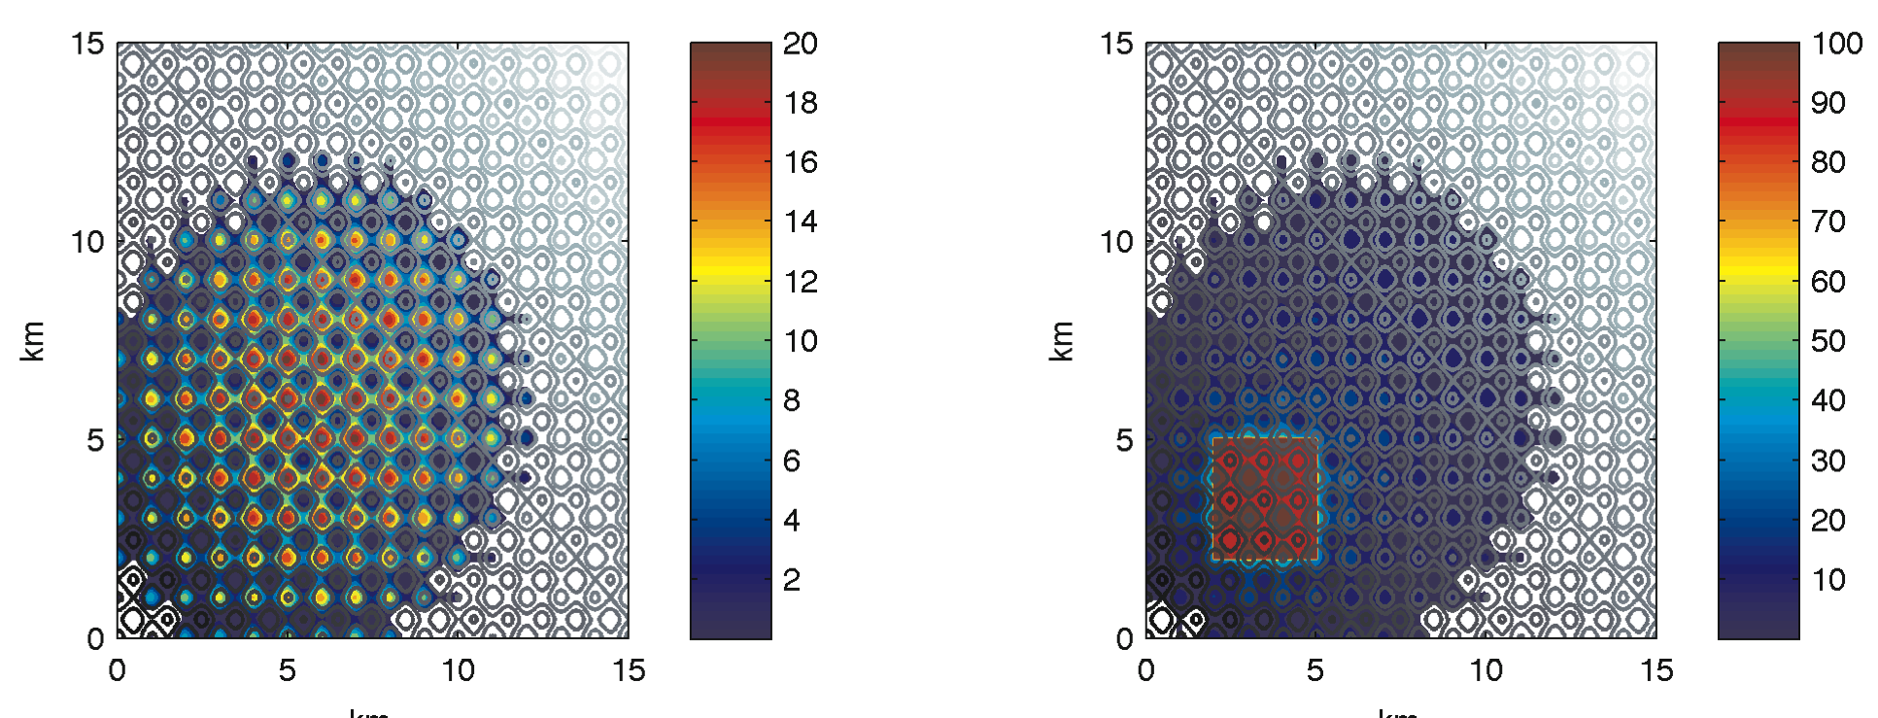
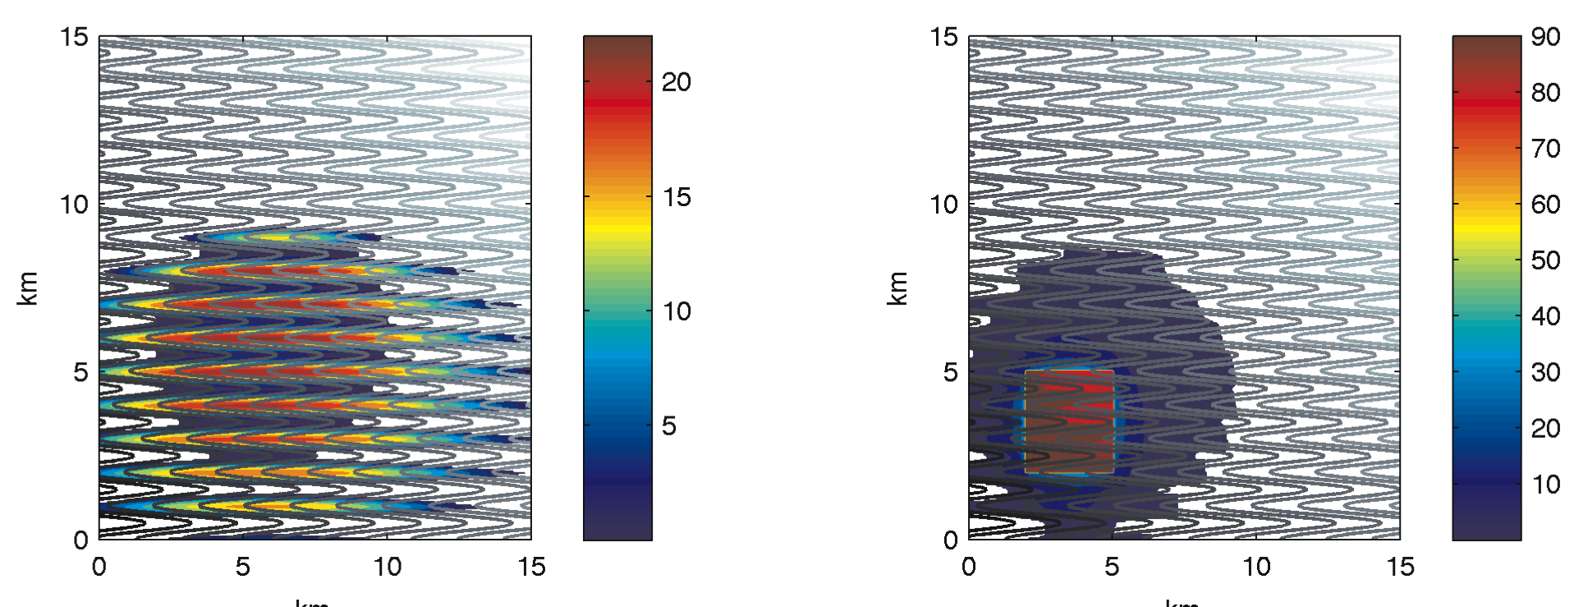
Migration under sinusoidal caprock (VE-simulation)
Mobile
Residual
Flat surface
a=0.05
1300 years
a=0
a=0.05
Sinusoidal surface
Gutter surface
Flat aquifer
Sinusoidal aquifer
1000 years
750 years of simulation time

Slide 32
Migration under sinusoidal caprock (VE-simulation)
Mobile
Residual
Flat surface
a=0.05
1300 years
a=0
Upslope tip distances
a=0.05
Sinusoidal surface
Gutter surface
Flat aquifer
Sinusoidal aquifer
1000 years
750 years of simulation time

Slide 33
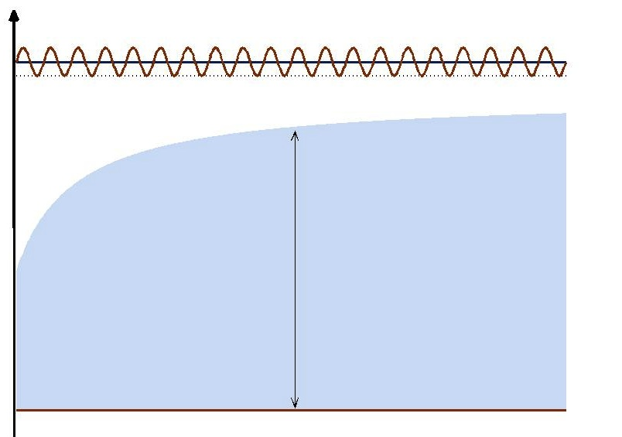
Effective model (1)

Slide 34
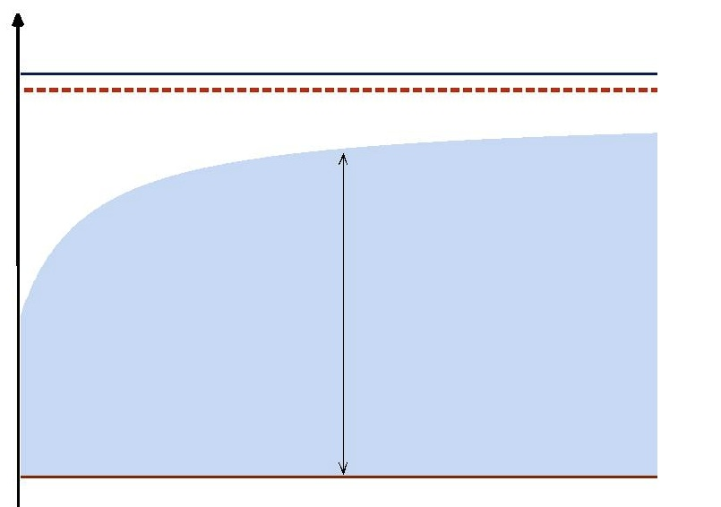
Effective model (1)

Slide 35
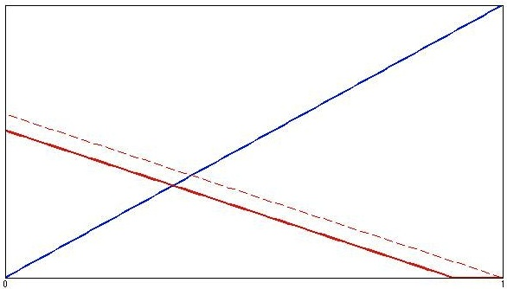
Effective model (1)

Slide 36
Effective model (1)
Gravity current analyzed from:

Slide 37
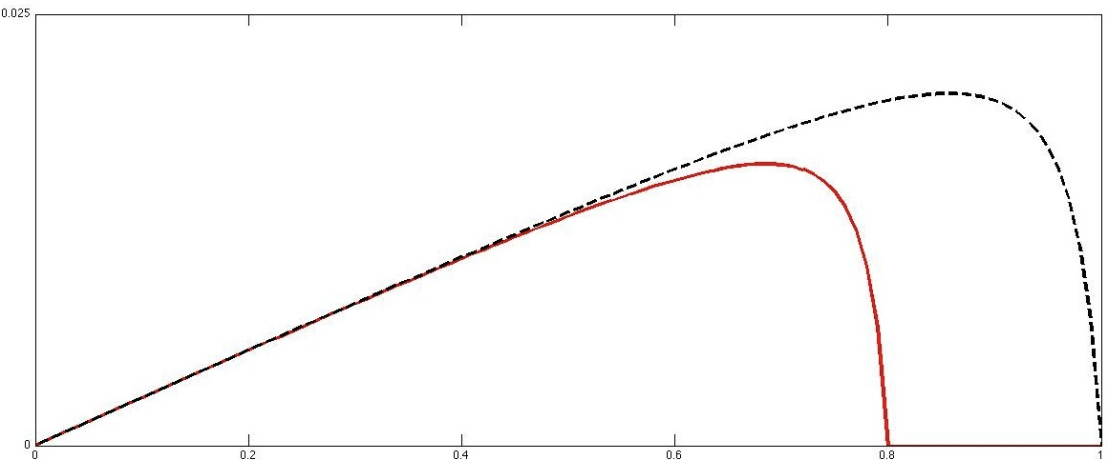
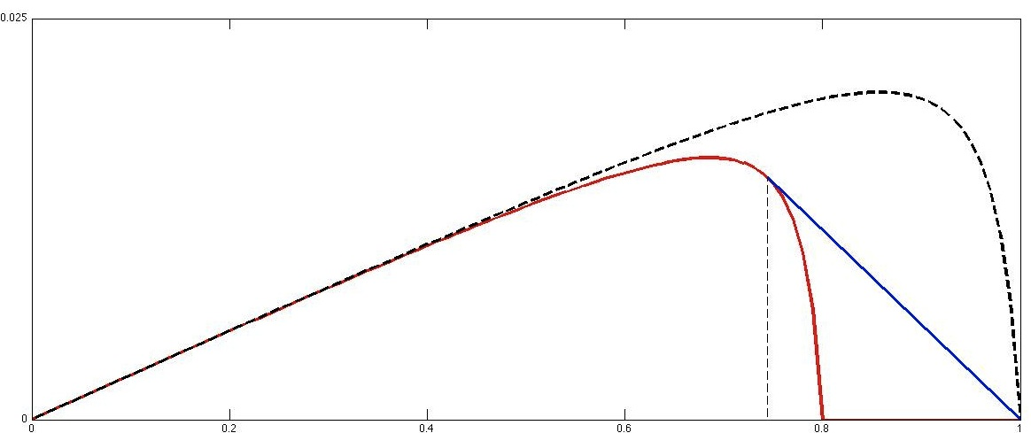
Effective model (1)
Mobility ratio:
Gravity flux:
Tip speed:

Slide 38
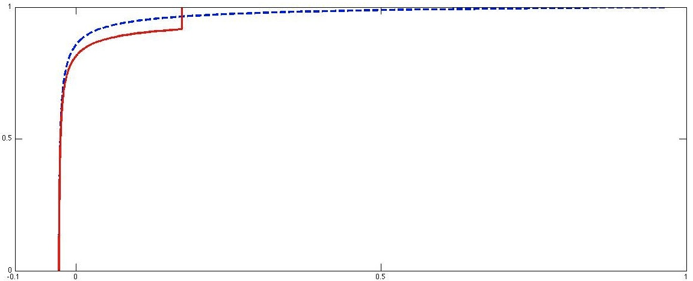
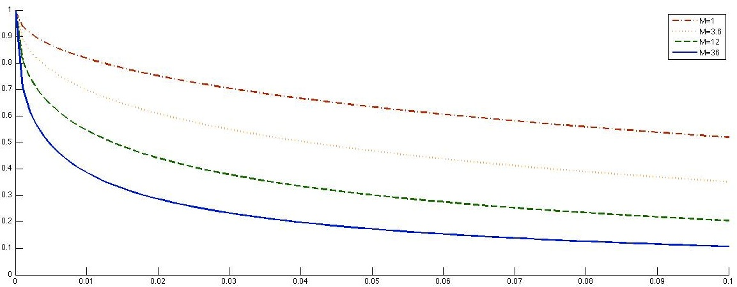
Effective model (1)
Similarity solution for leading tip:
Relative tip speeds:

Slide 39
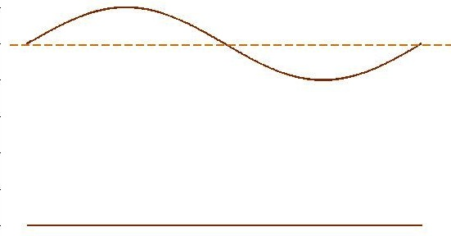
Effective model (2)
Single phase flow:
A) Depth-integration:
B) Harmonic average:

Slide 40
Effective model (2)
Two phase flow:
A) Depth-integration:
B) Harmonic average:

Slide 41
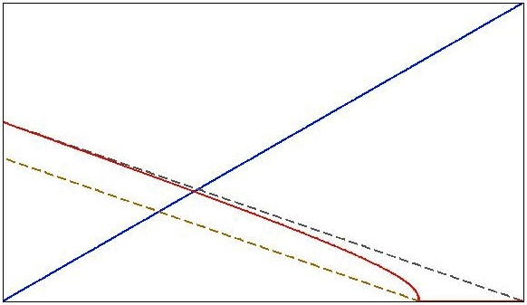
Effective model (2)

Slide 42
Effective vs Resolved Models
a=0.05
n=100
Effective Model

Slide 43
Effective vs Resolved Models
a=0.1
n=100
Effective Model

Slide 44
Effective vs Resolved Models
a=0.2
n=100
Effective Model

Slide 45
Tip Speed Comparison

Slide 46
Effective Model Comparison

Slide 47
Discussion
Caprock topography determines plume distribution and
  Traps CO₂ in domes and structural traps
  Slows upslope migration and decreases time to plume stabilization
Subscale topography important when it represents significant storage volumes and
Capillary fringe dominates if
Homogenization provides appropriate horizontal upscaling when caprock has a periodic structure
Caprock structure will create anisotropy in upscaled absolute and relative permeability
How to assess and parameterize subscale topography??

Slide 48
