Slide 1
Upscaling, Homogenization and HMM
Sergey Alyaev

Slide 2
Introduction
Discussion of scales in porous media problems

Slide 3
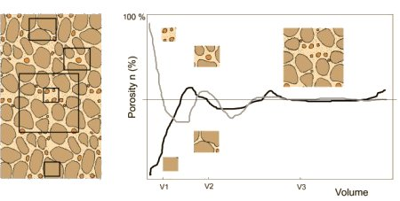
About Representative Elementary Volume (REV)
The effective parameters do not change sufficiently with perturbation of averaging domain
REV

Slide 4
Effective and equivalent permeability
Effective permeability
if the scale of averaging is large compare to the scale of heterogeneities
Equivalent permeability
permeability averaged over simulation grid block
The engineering idea
Extend theory justified for effective permeability to compute equivalent permeability
L. J. Durlofsky 1991

Slide 5
Understanding upscaling methods
We want to find coarse solution
Mass conservation is very important
Not particularly interested in fine scale except for its influence on the coarse flow

Slide 6
Averaged isotropic and anisotropic media
Anisotropy arises on larger scale
In geological formations there is a lot of heterogeneities
Notes:
Calculating equivalent permeability: A review

Slide 7
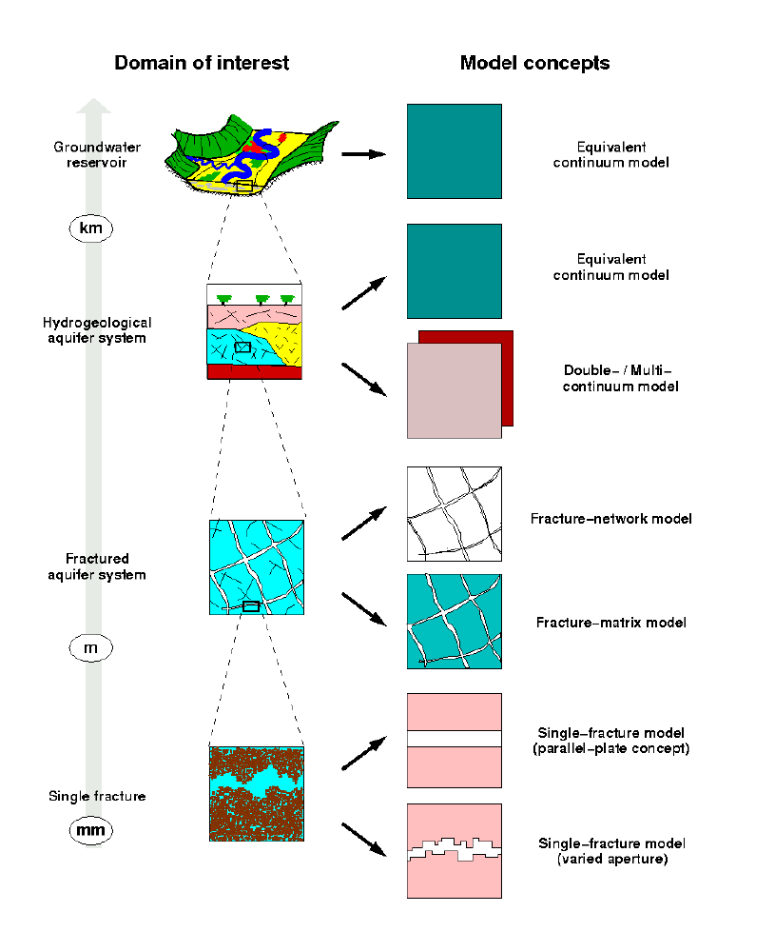
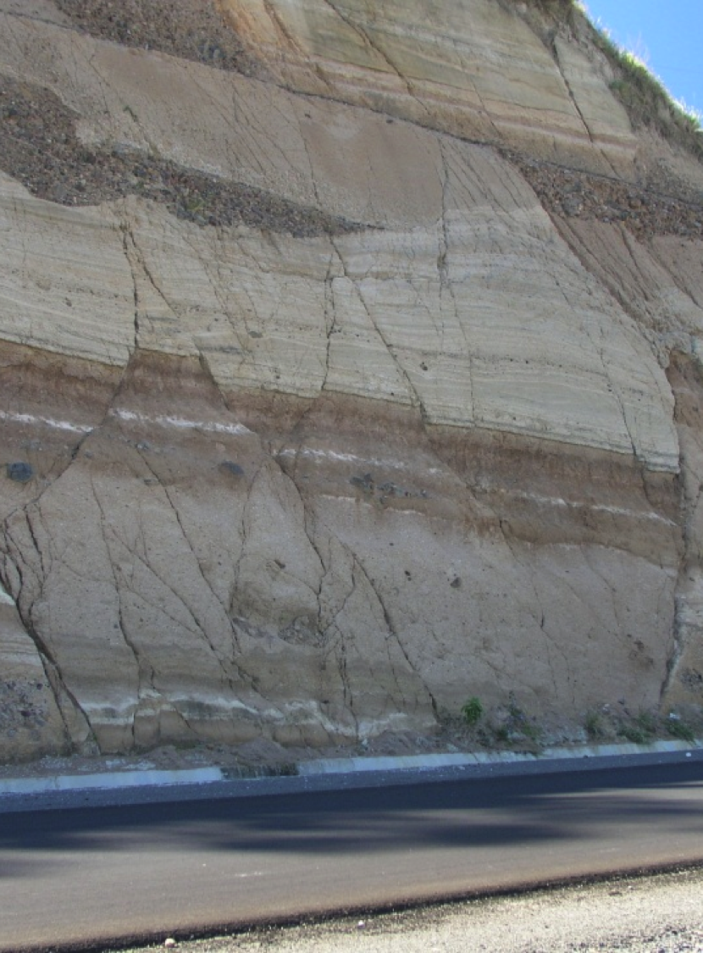
REV not well-defined
Field scale
km
Fracture networks
m
Single Fracture
mm
photo by Chuck DeMets

Slide 8
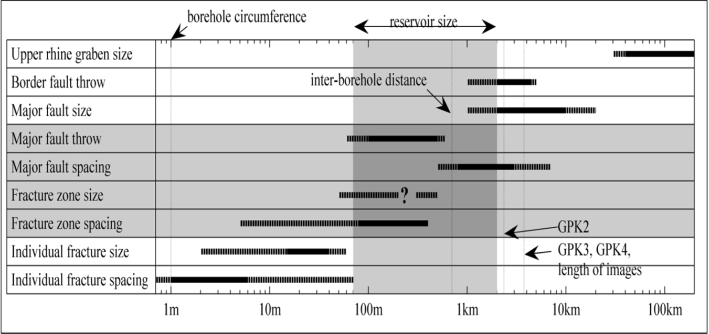
Multi-scale fractures
Slide from T. H. Sandve

Slide 9
Upscaling technics

Slide 10
Calculation of effective permeability
Problem formulation
Scheme of periodic medium
L. J. Durlofsky 1991

Slide 11
Classical engineering formulation
Pressure drop
Another option is linear boundary conditions
p=x a
L. J. Durlofsky 1991

Slide 12
Derivation of consistent formulation
L. J. Durlofsky 1991
Notes:
TODO: make illustration of boundary conditions on the figure and compare to classical upscaling

Slide 13
Assumptions of engineering approach
The cells contain REV
The grid is K-orthogonal
aligned with anisotropy

Slide 14
About K-orthogonally
MultiPoint Flux Approximation is consistent and convergent
MPFA reduces to Two-Point Flux Approximation when the grid is aligned with permeability tensor
I. Aavatsmark, 2002

Slide 15
Examples of K-orthogonally
a_{i} – surface normals
Criterion for parallelograms
2D
I. Aavatsmark, 2002
Notes:
Derivation requires a lot of background

Slide 16
Comparison
If (19c) is satisfied under assumption of (10b) the resulting solution is equivalent

Slide 17
Oversampling
Strategy
Properties
1
Solve problem on larger domain
2
Average in the cell only
Results are better
Hard to estimate quantitatively
Danger of overwork
spending more work than for the fine scale solution
C. L. Farmer, 2002

Slide 18
Comparison of upscaling and HMM

Slide 19
Comparison between HMM and numerical upscaling
Finite element on both scales
Evaluation of the permeability tensor in the quadrature points
Finite volume on the coarse scale (consistent for K-orthogonal grids)
Evaluation of permeability on control volumes

Slide 20
HMM is a numerical upscaling

Slide 21
There are similar proofs of convergence for both methods under similar assumptions
Assumptions on fine scale | Periodic | Random
Upscaling | Homogenization (e.g. G. Pavliotis, A. Stuart 2008) | To be presented (A. Bourgeat, A. Piatnitski 2004)
HMM | Presented yesterday (A. Abdulle 2005) | (W. E et. al. 2004)

Slide 22
Good cases and bad cases
Periodic media
Media with scale separation
Non-local features
No scale separation
Random media with small correlation length
a(x,y) periodic in y, smooth in x
Inhomogeneous with
Point sources
Some boundary conditions

Slide 23
Examples and coments
…where upscaling works and fails

Slide 24
Properties of permeability tensor
K is
  Symmetric
  Positive definite

Slide 25
Reduction of calculations
If we assume k is diagonal
p^{i} – solutions of cell problems with linear boundary conditions
We need 3 experiments to compute equivalent permeability
We can reduce to 1 experiment
  Proof is based on linear algebra
C. L. Farmer, 2002
Notes:
We may want to show the equality is true (page 67)
Farmer calls permeabilities effective

Slide 26
Examples
L. J. Durlofsky 1991

Slide 27
Counter example
Can be computed by rotation of the basis from previous
L. J. Durlofsky 1991

Slide 28
More examples where upscaling fails
True
Upscaled
True
Upscaled
k
a
C. L. Farmer, 2002
Notes:
2 cells, upscale for each
In the second case the true is harmonic

Slide 29
Dependence on boundary conditions
 |  | No flow
Sealed side
No flow
Pressure
Some flow
Periodic
No flow
C. L. Farmer, 2002

